Slide 1
My Soul Longs
Psalm 84

Slide 2
My Soul Longs Introduction

Slide 3
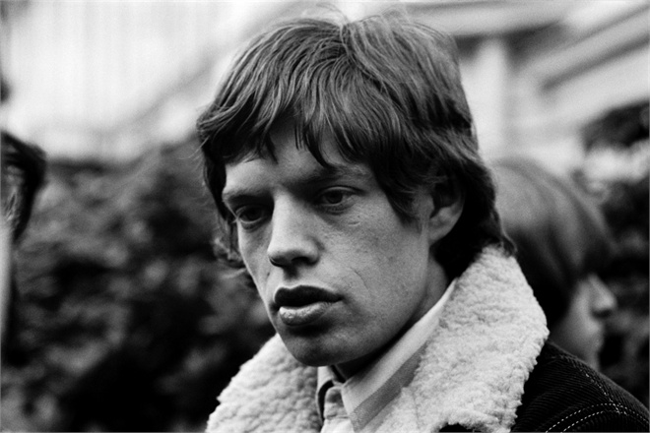
My Soul Longs Introduction
Back in 1965, Mick Jagger noticed the problem, but seems to have left it unresolved to this day.
I can't get no satisfaction
I can't get no satisfaction
'Cause I try and I try and I try and I try
I can't get no, I can't get no

Slide 4

My Soul Longs Introduction
We are created with a vacuum that can only be filled by God. We may try to fill it with other things; but what we are really thirsty for is Him, and we won’t be satisfied until we come into fellowship with Him allowing Him to satisfy the deepest need of our lives.
– Chuck Smith (1927 – 2013)

Slide 5
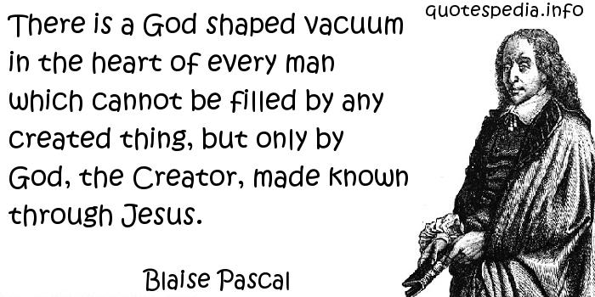
My Soul Longs Introduction

Slide 6
My Soul Longs Introduction
Great thought, and
Pascal doubtless would have agreed.
It’s doubtful he actually said those words.

Slide 7
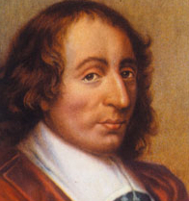
My Soul Longs Introduction
Pascal contemplated the universal human desire – and universal inability – to find fulfillment in this world.

Slide 8
My Soul Longs Introduction
What is it then that this desire and this inability proclaim to us, but that there was once in man a true happiness of which there now remain to him only the mark and empty trace, which he in vain tries to fill from all his surroundings, seeking from things absent the help he does not obtain in things present?
– Blaise Pascal (1623 – 1662), Pensées 425

Slide 9
My Soul Longs Introduction
But these are all inadequate, because the infinite abyss can only be filled by an infinite and immutable object, that is to say, only by God Himself.
– Blaise Pascal (1623 – 1662), Pensées 425

Slide 10
My Soul Longs Introduction
Mick Jagger might benefit from listening to Chuck Smith.
Or pseudo-Pascal quotations.
Or reading the real Pascal.
Or C. S. Lewis.

Slide 11
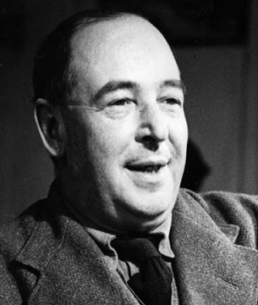
My Soul Longs Introduction
Creatures are not born with desires unless satisfaction for those desires exist. A baby feels hunger: well, there is such a thing as food. A duckling wants to swim: well, there is such a thing as water …
– C. S. Lewis (1898 – 1963)

Slide 12
My Soul Longs Introduction
… If I find in myself a desire which no experience in this world can satisfy, the most probable explanation is that I was made for another world.
– C. S. Lewis (1898 – 1963)

Slide 13
My Soul Longs Introduction
If none of my earthly pleasures satisfy it, that does not prove that the universe is a fraud. Probably earthly pleasures were never meant to satisfy it, but only to arouse it, to suggest the real thing.
– C. S. Lewis (1898 – 1963)

Slide 14
My Soul Longs Introduction
The composer of Psalm 84 found the real thing.
Let’s read that psalm.

Slide 15
My Soul Longs Psalm 84:1-2

Slide 16
My Soul Longs Psalm 84:1-2
Several times a year – Passover, Pentecost and Tabernacles – pilgrims would make their way to Jerusalem.
The writer of this psalm looked forward to that.

Slide 17
My Soul Longs Psalm 84:1-2
He not only loved the Temple.
He deeply loved the God he worshiped there.

Slide 18
My Soul Longs Psalm 84:1-2
I have rather … called this the “appetite for God” than “the love of God”. The “love of God” too easily suggests … all those negative or restrictive senses … These old poets do not seem to think that they are meritorious or pious … It has all the cheerful spontaneity of a natural, even a physical, desire.
– C. S. Lewis (1898 – 1963)

Slide 19
My Soul Longs Psalm 84:1-2
Notice the wording of it:
“my heart and flesh sing for joy to the living God.”
This desire seems to have come very naturally to our composer.

Slide 20
My Soul Longs Psalm 84:3-4

Slide 21
My Soul Longs Psalm 84:3-4
Birds very likely built nests in and around the temple.
Is the psalmist envious of them?
Maybe he speaks of birds in v.4.

Slide 22
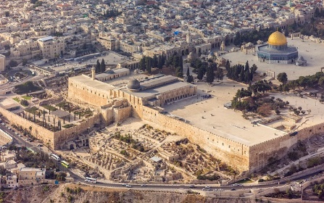
My Soul Longs Psalm 84:3-4
Israel-2013(2)-Aerial-Jerusalem-Temple Mount-Al-Aqsa and Dome of the Rock (SE exposure)" by Godot13 - Own work. From Wikimedia Commons

Slide 23
My Soul Longs Psalm 84:5-7

Slide 24
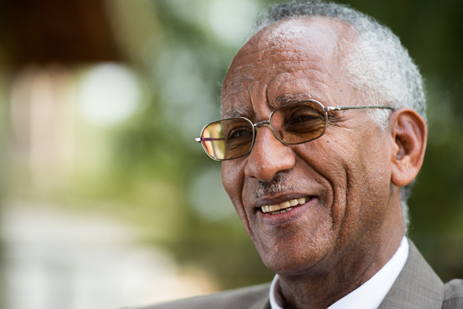
My Soul Longs Psalm 84:5-7
Their pilgrimage is not easy. They have to pass through the Valley of Baca, a name that may mean ‘the Valley of Weeping’ or ‘of Tears’ … But even this desolate valley does not deter them, for they make it a place of springs.
– Tewoldemedhin Habtu,
Africa International University

Slide 25
My Soul Longs Psalm 84:5-7
Your pilgrimage has probably not been easy either.
Do you believe that your “Valley of Baca,” of weeping or tears, can also become a place of life-giving springs?

Slide 26
My Soul Longs Psalm 84:5-7
Paul spoke of a “thorn” in his flesh, saying,
2 Corinthians 12:8-10 (ESV) ⁸ Three times I pleaded with the Lord about this, that it should leave me. ⁹ But he said to me, “My grace is sufficient for you, for my power is made perfect in weakness.” Therefore I will boast all the more gladly of my weaknesses, so that the power of Christ may rest upon me. ¹⁰ For the sake of Christ, then, I am content with weaknesses, insults, hardships, persecutions, and calamities. For when I am weak, then I am strong.

Slide 27
My Soul Longs Psalm 84:8-9

Slide 28
My Soul Longs Psalm 84:8-9
The psalmist has very real needs and concerns:
  Perhaps for protection
  Perhaps he prays in a time of national crisis – the phrase “your anointed” most likely refers to the king.

Slide 29
My Soul Longs Psalm 84:10-12

Slide 30
My Soul Longs Psalm 84:10-12
Remember Asaph in Psalm 73?
Psalm 73:25-26 (ESV) ²⁵ Whom have I in heaven but you?
And there is nothing on earth that I desire besides you.
²⁶ My flesh and my heart may fail, but God is the strength of my heart and my portion forever.

Slide 31
My Soul Longs Psalm 84:10-12
Or how about Paul?
Philippians 3:7-8 (ESV) ⁷ But whatever gain I had, I counted as loss for the sake of Christ. ⁸ Indeed, I count everything as loss because of the surpassing worth of knowing Christ Jesus my Lord. For his sake I have suffered the loss of all things and count them as rubbish, in order that I may gain Christ.

Slide 32
My Soul Longs Conclusion

Slide 33
My Soul Longs Conclusion
Our composer clearly loved to worship at the house of God in Jerusalem.
That’s not really an option for us.
But this attitude toward worship is still available.

Slide 34
My Soul Longs Conclusion
John 4:19-24 (ESV) ¹⁹ The woman said to him, “Sir, I perceive that you are a prophet. ²⁰ Our fathers worshiped on this mountain, but you say that in Jerusalem is the place where people ought to worship.”

Slide 35
My Soul Longs Conclusion
John 4:19-24 (ESV) ²¹ Jesus said to her, “Woman, believe me, the hour is coming when neither on this mountain nor in Jerusalem will you worship the Father. ²² You worship what you do not know; we worship what we know, for salvation is from the Jews.

Slide 36
My Soul Longs Conclusion
John 4:19-24 (ESV) ²³ But the hour is coming, and is now here, when the true worshipers will worship the Father in spirit and truth, for the Father is seeking such people to worship him. ²⁴ God is spirit, and those who worship him must worship in spirit and truth.”

Slide 37
My Soul Longs Conclusion
I must keep alive in myself the desire for my true country, which I shall not find until after death; I must never let it get snowed under or turned aside; I must make it the main object of life to press on to that other country and to help others to do the same.
– C. S. Lewis (1898 – 1963)

Slide 38
My Soul Longs Conclusion
Compare our love, longing, or desire with the psalmist’s.
Compare our knowledge of God’s love with his.

Slide 39
My Soul Longs Conclusion
Our knowledge is so much greater.
He didn’t know Jesus.
Our desire is probably less.
His worship seems more spiritual and truthful than ours.

Slide 40
My Soul Longs Conclusion
How do we increase our inner desire for heaven?
How do we make heaven the main object of our hearts?
How do we point them heavenward?

Slide 41
My Soul Longs Conclusion
Matthew 6:19-21 (ESV) ¹⁹ “Do not lay up for yourselves treasures on earth, where moth and rust destroy and where thieves break in and steal, ²⁰ but lay up for yourselves treasures in heaven, where neither moth nor rust destroys and where thieves do not break in and steal. ²¹ For where your treasure is, there your heart will be also.

Slide 42
My Soul Longs Conclusion
This passage can easily be used manipulatively.
For example, “Where have you laid up your treasure?”
But that would be the wrong focus.

Slide 43
My Soul Longs Conclusion
Matthew 6:19-21 (ESV) ¹⁹ “Do not lay up for yourselves treasures on earth, where moth and rust destroy and where thieves break in and steal, ²⁰ but lay up for yourselves treasures in heaven, where neither moth nor rust destroys and where thieves do not break in and steal. ²¹ For where your treasure is, there your heart will be also.

Slide 44
My Soul Longs Conclusion
Jesus is asking, “Where is your heart?”
Matthew 6:21 (ESV) For where your treasure is, there your heart will be also.

Slide 45
My Soul Longs Conclusion
Our hearts will follow our “treasure.”
Right desires develop when we give God all that is most valuable to us and take him for ourselves.

Slide 46
My Soul Longs Conclusion
We need to be willing to say, with Paul, that “I count everything as loss because of the surpassing worth of knowing Christ Jesus my Lord.”

Slide 47
My Soul Longs Conclusion
Back to Pascal:
[T]he infinite abyss can only be filled by an infinite and immutable object, that is to say, only by God Himself.
– Blaise Pascal (1623 – 1662), Pensées 425

Slide 48

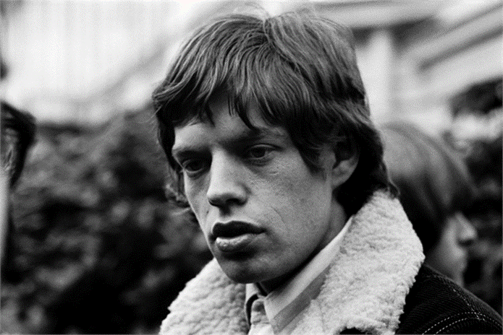
My Soul Longs Conclusion
Until we put Christ first, we’ll try and we’ll try and we’ll try, but we won’t get no …
Our hearts will be as empty as Pascal’s “infinite abyss.”

