Slide 1
Forgiven
Psalm 32

Slide 2
Forgiven Introduction

Slide 3
Forgiven Introduction
In the Genesis account, Adam and Eve ate the forbidden fruit – from the Tree of the Knowledge of Good and Evil.
The result was a series of curses that we still see the evidence for today.
Since the time of Augustine of Hippo (354-430), Christians normally refer to these events as “The Fall of Adam.”

Slide 4

Forgiven Introduction
Augustine described things as follows:

Slide 5
Forgiven Introduction
Augustine described things as follows:
In his original state Adam was “able not to sin and not to die.”

Slide 6
Forgiven Introduction
Augustine described things as follows:
In his original state Adam was “able not to sin and not to die.”
In his potential state (had he eaten from the Tree of Life), Adam would have been “not able to sin and die.”

Slide 7
Forgiven Introduction
Augustine described things as follows:
In his original state Adam was “able not to sin and not to die.”
In his potential state (had he eaten from the Tree of Life), Adam would have been “not able to sin and die.”
In his actual state (after The Fall), Adam was “not able not to sin and die.”

Slide 8
Forgiven Introduction
We may be tempted to think of Adam’s Fall as the minor infraction of one man.
On this view Adam ate a simple fruit and, as a result, God is eternally and unjustly punishing the human race.

Slide 9
Forgiven Introduction
It’s better to think of The Fall as Adam ingesting a brain-eating poison.
From that time on he was not able to think with complete clarity and his body slowly but surely began to die.

Slide 10
Forgiven Introduction
We might also think of The Fall as Adam unleashing some radioactive substance.
His DNA was altered so as to cause birth defects in all succeeding generations.
The whole environment of earth was now contaminated in ways that were completely out of Adam’s control.

Slide 11
Forgiven Introduction
We now all have intimate knowledge of good and evil.
We see the two sides warring within our own soul.
In our natural state we now all find ourselves in rebellion against God.

Slide 12
Forgiven Introduction
Our rebellion is not always totally active – like an army of peasants storming the gates of the king’s castle.
It can be more passive-aggressive – like the secession of southern states in the Civil War.
We have seceded from God’s universe and are engaged in a futile attempt to establish a universe of our own.

Slide 13
Forgiven Introduction
We see any exercise of God’s authority as him abusing his authority – unless it is exercised against someone else.
We are blind to our own fatal flaws.
Having come to know both good and evil, the evil has warped our minds.
We are now not always able to tell the difference.

Slide 14
Forgiven Introduction
In Psalm 32, David expresses his need to be forgiven.
It is a joyful psalm, because forgiveness is a joyful thing.
But as with Lincoln’s amnesty offered to Confederate soldiers, we have be willing to give up our rebellion.

Slide 15
Forgiven Psalm 32

Slide 16
Forgiven Psalm 32
Many people believe this was written along with Psalm 51.
That would be after David admitted his sin in the matter of Bathsheba and Uriah the Hittite.

Slide 17
Forgiven Psalm 32:1-2

Slide 18
Forgiven Psalm 32:1-2
There is some overlap between the different words used here. Still, to generalize:
Transgression is crossing over a line.
Sin is akin to missing a mark.
Iniquity is wrongdoing with a focus on its liability or guilt.

Slide 19
Forgiven Psalm 32:1-2
All of them are cured when we receive forgiveness apart from works – trusting in the work of Christ on the cross.

Slide 20
Forgiven Psalm 32:1-2
Romans 4:5–8 And to the one who does not work but believes in him who justifies the ungodly, his faith is counted as righteousness, just as David also speaks of the blessing of the one to whom God counts righteousness apart from works:
  “Blessed are those whose lawless deeds are forgiven, and whose sins are covered; blessed is the man against whom the Lord will not count his sin.”

Slide 21
Forgiven Psalm 32:1-2
An absence of deceit is equivalent to an honesty about our sin before God.
See the next few verses.

Slide 22
Forgiven Psalm 32:3-5

Slide 23
Forgiven Psalm 32:3-5
God forgave David’s sin after he confessed it to God.
2 Samuel 12:13
David said to Nathan, “I have sinned against the Lord.” And Nathan said to David, “The Lord also has put away your sin; you shall not die.

Slide 24
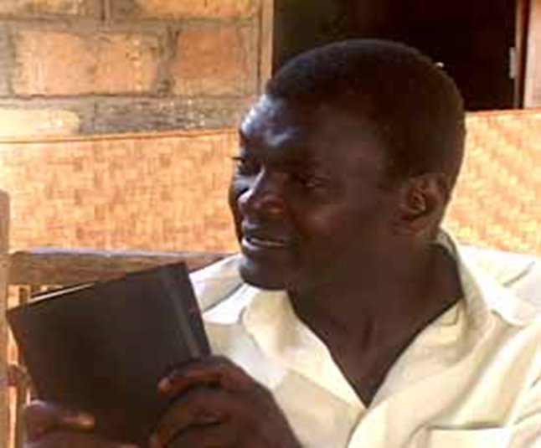
Forgiven Psalm 32:3-5
This psalm should not lead us to assume that all illness, poverty or suffering is the result of unconfessed sin … But neither should we deny that when sin is present, it breaks our relationship with the living God and hinders us from experiencing his blessing.
– Nupanga Weanzana, Bangui Evangelical School of Theology, C.A.R.

Slide 25
Forgiven Psalm 32:3-5
God does not promise to forgive our sins because they are small, or because we are sorrowful.
God asks us to confess them to Him in order to receive forgiveness.

Slide 26
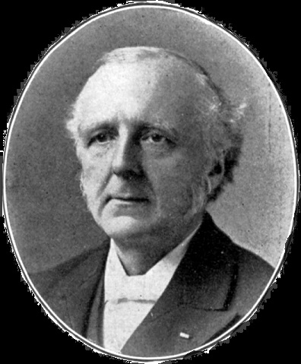
Forgiven Psalm 32:3-5
We never realize the blessedness of forgiveness so sweetly as when we have known the burden of unforgiven sin … There is no cure for the soul like the heartfelt confession of sin.
– F. B. Meyer (1847 – 1929)

Slide 27
Forgiven Psalm 32:3-5
Compare David’s experience to the teaching of John:
1 John 1:8–9
If we say we have no sin, we deceive ourselves, and the truth is not in us. If we confess our sins, he is faithful and just to forgive us our sins and to cleanse us from all unrighteousness.

Slide 28
Forgiven Psalm 32:3-5
God is faithful and just.
He is faithful to his promise to forgive.
He is just because Christ bore the penalty for our sins when he died on the cross.
God has no desire to extract the payment of a debt from you, which Christ has already paid in full.

Slide 29
Forgiven Psalm 32:6-7

Slide 30
Forgiven Psalm 32:6-7
Some people believe they will be able to make their peace with God at their own convenience.
David says, “when you may be found,” because he knows that a convenient time may never come.

Slide 31
Forgiven Psalm 32:6-7
deliverance = escape
In 2 Peter 1:4, Peter writes that we have been given …
… his precious and very great promises, so that through them you may become partakers of the divine nature, having escaped from the corruption that is in the world because of sinful desire.

Slide 32
Forgiven Psalm 32:8-9

Slide 33
Forgiven Psalm 32:8-9
We need more than personal instruction; we are travelling through an unknown land, and require direction for the way …
– F. B. Meyer (1847 – 1929)

Slide 34
Forgiven Psalm 32:8-9
… Our Guide accompanies us. He counsels us with his eye upon us, detecting every pitfall and chasm, and warning us; perhaps even guiding us by the movement of his eye.
– F. B. Meyer (1847 – 1929)

Slide 35
Forgiven Psalm 32:8-9
Be not like a horse or a mule.
  Horses love to run wild. They need to be tamed and brought under control.
  Mules are stubborn and have to be pulled along.
  God wants us to avoid both extremes in our relationship with Him.

Slide 36
Forgiven Psalm 32:10

Slide 37
Forgiven Psalm 32:10
This verse sounds like the book of Proverbs.

Slide 38
Forgiven Psalm 32:10
This verse sounds like the book of Proverbs.
Proverbs 10:24 What the wicked dreads will come upon him, but the desire of the righteous will be granted.

Slide 39
Forgiven Psalm 32:10
This verse sounds like the book of Proverbs.
Proverbs 10:24 What the wicked dreads will come upon him, but the desire of the righteous will be granted.
Proverbs 13:6 Righteousness guards him whose way is blameless, but sin overthrows the wicked.

Slide 40
Forgiven Psalm 32:11

Slide 41
Forgiven Psalm 32:11
Some form of the words “joy” or “rejoice” appears more than 100 times in the Book of Psalms.
God intends our relationship with Him to be a joyful one.

Slide 42
Forgiven Psalm 32:11
David’s unconfessed sin stood in the way of his joy.
It made him depressed and gloomy and sorrowful.
When he admitted his sin, his depression went away.
True forgiveness led to happiness and rejoicing.

Slide 43
Forgiven Conclusion

Slide 44
Forgiven Conclusion
Our souls were not designed to bear the overwhelming weight of our sin.
Yet until we acknowledge our sin before God, and are forgiven, true righteousness will never be achieved.
Our first step may have to be to ask God to open our eyes to our sin and help us to see it clearly.

Slide 45
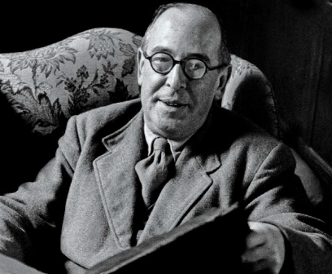
Forgiven Conclusion
When a man is getting better he understands more and more clearly the evil that is still left in him. When a man is getting worse he understands his own badness less and less … This is common sense, really …
– Clive Staples Lewis (1898 – 1963)

Slide 46
Forgiven Conclusion
… You understand sleep when you are awake, not while you are sleeping. You can see mistakes in arithmetic when your mind is working properly: while you are making them you cannot see them. You can understand the nature of drunkenness when you are sober, not when you are drunk.
– Clive Staples Lewis (1898 – 1963)

Slide 47
Forgiven Conclusion
So forgiveness is not merely for the obviously wicked.
It is for all of us who understand that “all our righteous deeds are like a polluted garment.” (Isaiah 64:6)
All of us have been tainted by the Fall of Adam and sinful acts are the inevitable result.

Slide 48
Forgiven Conclusion
Yet our situation is different from Adam’s – here on this side of the Fall.
We have never been “able not to sin and not to die.”
We have only been “not able not to sin and die.”
But one day by God’s grace our transformation shall be complete and we shall be “not able to sin and die.”

Slide 49
Forgiven Conclusion
God offers us an antidote for the poison of our sin.
He offers a protective shield and total cure for the effects of our radioactive nature.
He offers an amnesty for our rebellion.
We are secure.

Slide 50
Forgiven Introduction
Forgiveness is the remission of sins. For it is by this that what has been lost, and was found, is saved from being lost again.
– Augustine of Hippo (354 – 430)

Slide 51
Forgiven Conclusion
We’re going to ask the worship team to come up.
Spend some time in personal confession.
Receive the complete forgiveness that God intends for you.

Slide 52
Forgiven Conclusion
In closing let’s reread Psalm 32:1, 2 & 11.

