Slide 1
There Is No God
Psalm 14

Slide 2
There Is No God Introduction

Slide 3
There Is No God Introduction
Question: What do Richard Dawkins, Gwyneth Paltrow and the Dalai Lama all have in common?

Slide 4
There Is No God Introduction
Question: What do Richard Dawkins, Gwyneth Paltrow and the Dalai Lama all have in common?
Answer: We’ll let them answer for themselves.

Slide 5
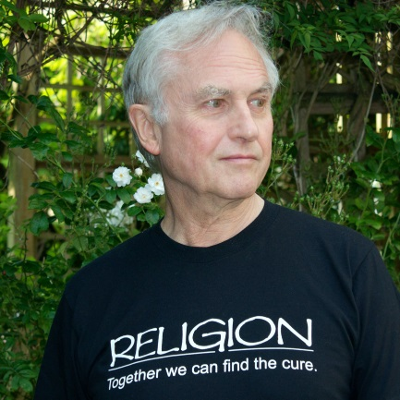
There Is No God Introduction
We are all atheists about most of the gods that humanity has ever believed in. Some of us just go one god further.
― Richard Dawkins,
in The God Delusion

Slide 6
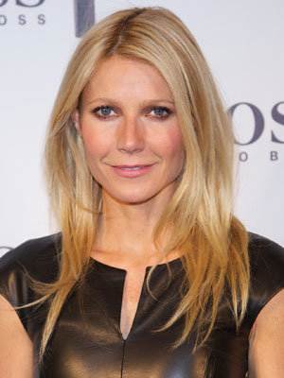
There Is No God Introduction
I don’t believe in religion … Religion is the cause of all the problems in the world … More people have died because of religious conflict than any other reason.
– Gwyneth Paltrow in
Women’s Day, April 20, 2010

Slide 7
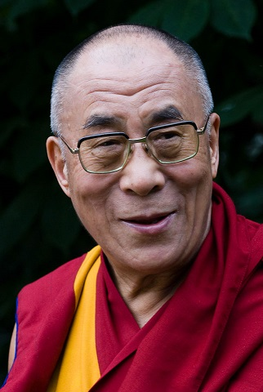
There Is No God Introduction
Buddhism does not accept a theory of God, or a creator. According to Buddhism, one's own actions are the creator, ultimately.
– Dalai Lama, in Policy of Kindness

Slide 8
There Is No God Introduction
Needless to say, the Bible differs with them all at this point.

Slide 9
There Is No God Introduction
Once you know God, it’s really hard to say, “No, God.”
It’s even harder to imagine that there is no God.

Slide 10
There Is No God Psalm 14

Slide 11
There Is No God Psalm 14
This Psalm is repeated almost word-for word in Psalm 53.
The Holy Spirit and the human compiler of the book must have both thought we needed a second reminder.

Slide 12
There Is No God Psalm 14:1

Slide 13
There Is No God Psalm 14:1
The word David uses for “fool” is Nabal.
We may remember Nabal as the first husband of Abigail, who treated David and his men very badly.
He died shortly thereafter. David married his widow.

Slide 14
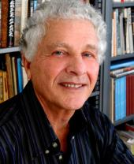
There Is No God Psalm 14:1
The thrust of this line is more moral than theological. The concern is not a philosophical question of God’s existence but the scoundrel’s lack of conscience, his feeling that he can act with impunity, because he thinks he need not fear divine retribution.
– Robert Alter, Professor of Hebrew and Comparative Literature, UC Berkeley

Slide 15
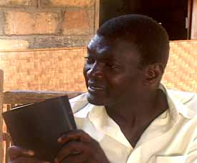
There Is No God Psalm 14:1
‘Fools’ … are not mentally deficient in any way, … are not even necessarily confessed atheists, but [those] whose lives indicate that for all practical purposes they live as atheists.
– Nupanga Weanzana, Bangui Evangelical School of Theology, Central African Republic

Slide 16
There Is No God Psalm 14:1
The fool David is talking about here denies God’s rule in his life and in the life of the society. He refuses to admit that he is accountable to the Sovereign of the world for what he does.
– Nupanga Weanzana, Bangui Evangelical School of Theology, Central African Republic

Slide 17
There Is No God Psalm 14:1
God desires to engage each of us on the most personal level possible.
This is undermined when we call his authority – or even his existence – into question.

Slide 18
There Is No God Psalm 14:1
The difference between foolishness and wisdom is the difference between those who resist God’s involvement in their lives and those who welcome it.

Slide 19
There Is No God Psalm 14:2-3

Slide 20
There Is No God Psalm 14:2-3
Paul uses these verses as part of his case to explain that the whole world is guilty before God.
See Romans 3:9-12.

Slide 21
There Is No God Psalm 14:2-3
The Bible’s starting point is not trying to prove God’s existence.
God’s existence in the Bible is assumed.
We are separated from him due to our own:
  Lack of faithfulness (at best)
  Rebellion (at worst)

Slide 22
There Is No God Psalm 14:2-3
Once you know God, it’s really hard to say, “No, God.”
It’s even harder to imagine that there is no God.

Slide 23
There Is No God Psalm 14:4-6

Slide 24
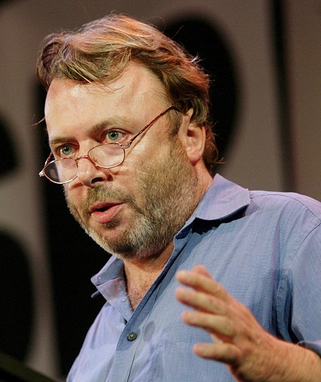
There Is No God Psalm 14:4-6
Sigmund Freud was quite correct to describe the religious impulse … as essentially ineradicable until or unless the human species can conquer its fear of death and its tendency to wish-thinking.
– Christopher Hitchens (1949-2011, in God Is Not Great: How Religion Poisons Everything

Slide 25
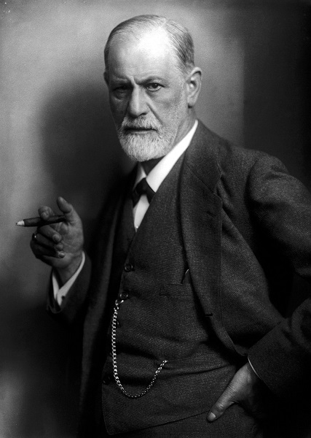
There Is No God Psalm 14:4-6
When the growing individual finds that he is destined to remain a child for ever, that he can never do without protection against strange powers, he lends those powers the features belonging to the figure of his father …
– Sigmund Freud (1856-1939),
The Future of an Illusion, 1929

Slide 26
There Is No God Psalm 14:4-6
… he creates for himself the gods whom he dreads, whom he seeks to propitiate, and whom he nevertheless entrusts with his own protection. Thus his longing for a father is a motive identical with his need for protection against the consequences of his human weakness.
– Sigmund Freud (1856-1939),
The Future of an Illusion, 1929

Slide 27
There Is No God Psalm 14:4-6
According to this Psalm, the greater exercise in wish-thinking looks like atheism or related outlooks.
Some people really wish that God was only for those who are less intelligent or more naïve than they are.
Some people wish there would be no God to ever hold them accountable for their actions.

Slide 28
There Is No God Psalm 14:4-6
It’s never a question of certain people (We) being better than others (They).
David sees those who act as if God is irrelevant as those who will ultimately be put to shame.
The righteous are those who take refuge in God.

Slide 29
There Is No God Psalm 14:7

Slide 30
There Is No God Psalm 14:7
Salvation = safety, rescue, deliverance
In Hebrew it is yeshuah, directly connected to the Hebrew name of Jesus.
Also see the repeating refrain is Psalms 42-43.

Slide 31
There Is No God Psalm 14:7
The final verse of this psalm is an encouragement for us to turn to the Lord and remain faithful.
The world may well be wicked – or in denial about God.

Slide 32
There Is No God Psalm 14:7
We may feel that God has nothing at all to offer.
We may be tempted to reject God to be like the world.
But to do so would make us all fools.
Psalm 14 warns us not to give in to this temptation.

Slide 33
There Is No God Conclusions

Slide 34
There Is No God Conclusions
Once you know God, it’s really hard to say, “No, God.”
It’s even harder to imagine that there is no God.

Slide 35
There Is No God Conclusions
Christians face challenges on a couple of different fronts.
First of all, we live in a time and culture much like that of the early church, in which the message of the gospel is despised.

Slide 36
There Is No God Conclusions
For Buddhists, the universe has no first cause and hence no creator, nor can there be such a thing as a permanent, primordially pure being.
– The Dalai Lama, “Buddhism and Other Religions”, in Philosophy of Religion: Selected Readings

Slide 37
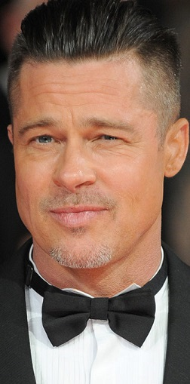
There Is No God Conclusions
I'm probably 20 percent atheist and 80 percent agnostic. I don't think anyone really knows. You'll either find out or not when you get there, until then there's no point thinking about it.
― Brad Pitt, NY Daily News,
July 23, 2009

Slide 38
There Is No God Conclusions
I cannot know for certain but I think God is very improbable, and I live my life on the assumption that he is not there.
― Richard Dawkins,
in The God Delusion

Slide 39
There Is No God Conclusions
So there we have one view that challenges the gospel.
Simultaneously, we see that Paul was right, the whole world is guilty before God – and that includes us.
We need a Savior every bit as much as the rest of the world.

Slide 40
There Is No God Conclusions
The solution God provides is good for all.
See Paul’s later words in Romans 3:21-26.

Slide 41
There Is No God Conclusions
God is more than a judge, more than a creator and more than a father figure.
And you are made in His image, made to enjoy him deeply and forever.

Slide 42
There Is No God Conclusions
Jesus, though fully God, loved you enough to die for you, even when you were in complete rebellion against him.
Don’t be a fool. Trust Jesus.

