Slide 1
Finding Wisdom
Job 28

Slide 2
Finding Wisdom Introduction

Slide 3
Finding Wisdom Introduction
What is the essential thing we need that will allow us to look back on a life well-lived?

Slide 4
Finding Wisdom Introduction
What is the essential thing we need that will allow us to look back on a life well-lived?
  Is it a good upbringing?
  Is it a good education?
  A good family?
  A good job?
  Money?
  Good luck?

Slide 5
Finding Wisdom Introduction
All of those things can be helpful, but the bottom-line answer the Bible gives is, “Wisdom.”
Wisdom is the thing we need to thrive.

Slide 6
Finding Wisdom Introduction
Certain books are the Bible’s Wisdom Literature.
Job is the first of these – along with Proverbs, Ecclesiastes and some of the Psalms.

Slide 7
Finding Wisdom Introduction
In ancient times, training in wisdom was considered an essential part of personal development.
It prepared those in positions of leadership in fields like law, government or the military.
It was how the old prepared the young to live life.
Wisdom is the topic of Job 28.

Slide 8
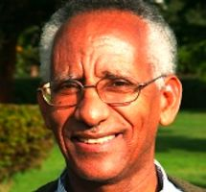
Finding Wisdom Introduction
The search for wisdom is at the heart of this entire poem. It would not be too much to say that it is also the theme of the entire book of Job.
– Prof. T. Habtu,
Ethiopian Bible Teacher

Slide 9
Wisdom – What is it?

Slide 10
Wisdom – What is it?
It is a moral rather than an intellectual quality.
It is stewardship of whatever knowledge we have.
It is skill in the art of living life – the ability to know what to do as well as how and when to do it.

Slide 11
Wisdom – What is it?
The key verse in this chapter is the last one.
Job 28:28 … Behold, the fear of the Lord, that is wisdom, and to turn away from evil is understanding.

Slide 12
Finding Wisdom Job 28:1-11

Slide 13
Finding Wisdom Job 28:1-11
Human ingenuity and effort can accomplish amazing things.
In our day we might add any number of technological wonders to Job’s list.

Slide 14
Finding Wisdom Job 28:1-11
But true wisdom is not present in any of these.
In other words, any number of smart, hard-working people will never look back on a well-lived life.

Slide 15
Finding Wisdom Job 28:12-19

Slide 16
Finding Wisdom Job 28:12-19
Wisdom is elusive – not easy to find.
It may be highly esteemed, but cannot be bought at a price.

Slide 17
Finding Wisdom Job 28:20-22

Slide 18
Finding Wisdom Job 28:20-22
Wisdom remains elusive.
Where do we find it?

Slide 19
Finding Wisdom Job 28:23-28

Slide 20
Finding Wisdom Job 28:23-28
We find wisdom when we truly find God.
And when we truly find God in all his love, holiness, majesty and grace, we will fear him.

Slide 21
Finding Wisdom Job 28:23-28
Again, the key verse in this chapter is the last one.
Job 28:28 … Behold, the fear of the Lord, that is wisdom, and to turn away from evil is understanding.
Let’s listen to a few commentators on this verse.

Slide 22
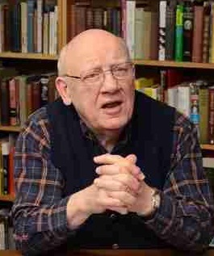
Finding Wisdom Job 28:28
What is “the fear of the Lord”? It is loving reverence for God, who He is, what He says, and what He does. It is not a fear that paralyzes, but one that energizes …
– Warren Wiersbe

Slide 23
Finding Wisdom Job 28:28
Like Job, when you fear the Lord, you depart from evil. The “fear of the Lord” is the fear that conquers fear; for if you fear God, you need not fear anyone else.
– Warren Wiersbe

Slide 24
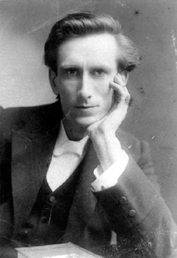
Finding Wisdom Job 28:28
The man who prays ceases to be a fool, while the man who refuses to pray nourishes a blind life within his own brain …
– Oswald Chambers (1874 – 1917)

Slide 25

Finding Wisdom Job 28:28
It’s all tied together. If a person is living a wicked life, that person doesn’t have the fear of the Lord in his heart … To live in sin is folly.
– Pastor Chuck Smith (1927 – 2013)

Slide 26
Fearing God in a World That Doesn’t

Slide 27
Fearing God in a World That Doesn’t
Fearing God is not the same as being religious.
It is being submitting to, and walking in relationship with the God who has revealed himself in the Bible.
This can be hard for some people to accept.

Slide 28
Fearing God in a World That Doesn’t
We, in our culture, display an interesting paradox.
We desire complete freedom.
We also seem to question whether free will and personal responsibility are even possible.

Slide 29
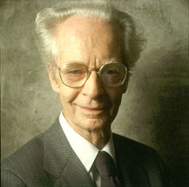
Fearing God in a World That Doesn’t
My behavior at any given moment has been nothing more than the product of my genetic endowment, my personal history, and the current setting.
– B. F. Skinner (1904 – 1990)
Harvard Professor of Psychology

Slide 30
Fearing God in a World That Doesn’t
Let’s assume Dr. Skinner was right.
He claimed, “Free will is but an illusion."
We are the mere product of our genetics and environment.

Slide 31
Fearing God in a World That Doesn’t
Then all of Skinner’s writing must be like that too.
He could not have arrived at his ideas freely.
It was the product of his genetics and environment as displayed in the neurons of his brain.

Slide 32
Fearing God in a World That Doesn’t
Job would not agree with B.F. Skinner.
Job is telling us to seek and find God.
And in fearing God – the God of the Bible – we will find wisdom.

Slide 33
Fearing God in a World That Doesn’t
By the way, in 1981, at age 77, Skinner did an interview with the NY Times. The title of the article says a lot:
B.F. SKINNER NOW SEES LITTLE HOPE FOR THE WORLD'S SALVATION
In the last line, he says, it is ''too late - I don't see any hope for it.''

Slide 34
Fearing God in a World That Doesn’t
What about other religions?

Slide 35
Fearing God in a World That Doesn’t
What about other religions?
Job was not an Israelite.
All indications are that he live in an earlier time.
He is not advocating devotion to the Lord as an Egyptian, Babylonian or Canaanite would advocate his own gods.

Slide 36
Fearing God in a World That Doesn’t
What about other religions?
Job is not saying to be true to the religion of your people.
He is commending the God of the Bible to anyone who will hear him.

Slide 37
Finding Wisdom Conclusions

Slide 38
Finding Wisdom Conclusions
The first step toward true wisdom is a humble, reverent and respectful attitude toward God.
It is not enough to study about God, to listen to sermons or come to church.
We must also walk in obedience – turning away from evil.

Slide 39
Finding Wisdom Conclusions
Godly wisdom is not at all abstract; it is extremely personal and totally practical.
Remember what God said about Job at the beginning?
Look back at Job 1:1 & 1:8.

Slide 40
Finding Wisdom Conclusions
Let’s also take a look at these few verses:
  Ps 111:10
  Proverbs 9:10
  Col 2:1-3

Slide 41
Finding Wisdom Conclusions
Christ is the source of all wisdom and knowledge.
The better we know Christ, the more we will desire to become like him.
As we become like him, we will be turning away from evil, walking in wisdom and growing in our grasp of God’s will.

Slide 42
Finding Wisdom Conclusions
We find wisdom when we find Christ.
Wisdom is getting to know him and learning to walk more faithfully with him.
This is what it is to fear the Lord.
This is what it takes to depart from evil.
This is what we need in order to look back someday on a life well-lived.

