Slide 1
An Ordinary Hero
2 Chronicles 17 – 20

Slide 2
An Ordinary Hero Introduction

Slide 3
An Ordinary Hero Introduction
The Bible is very realistic about its heroes and villains.
The human characters are very human – people we can usually identify with.

Slide 4
An Ordinary Hero Introduction
King Jehoshaphat is one of those.
Jehoshaphat goes down as a good king, but one whose legacy was imperfect.

Slide 5
An Ordinary Hero Introduction
The Bible presents him as good man who made a few big mistakes that somewhat tarnished his legacy.
Still, overall, he gets good reviews.

Slide 6
An Ordinary Hero Introduction
Two big lessons from the life of Jehoshaphat (I was trying to make it just one, but couldn’t decide):
A generally good life can be seriously tarnished by terrible mistakes if we aren’t careful.
Even if we’ve made some terrible mistakes, persistently trying to please the Lord can lead to some serious blessing.

Slide 7
An Ordinary Hero Introduction
One thing we don’t see in the Bible:
Jehoshaphat never seems to jump. Sorry. ☹
Wikipedia says the phrase “Jumpin’ Jehoshaphat!” first appears in an 1866 novel set in Texas. (I had to check.)

Slide 8
An Ordinary Hero Chapter 17

Slide 9
An Ordinary Hero Chapter 17
17:3-4 He did not seek the Baals, but sought the God of his father … not according to the practices of Israel.
Jehoshaphat’s faithfulness in Judah is highlighted by the unfaithfulness of Ahab and Israel at this time.
Jehoshaphat’s rejection of idolatry went against the current of his time.

Slide 10
An Ordinary Hero Chapter 17
17:6 he took the high places and the Asherim out of Judah.
Jehoshaphat’s father Asa did the same thing in 14:3-5.
It only takes one generation for a nation to fall away.

Slide 11
An Ordinary Hero Chapter 17
17:7-9 he sent his officials … And they taught in Judah, having the Book of the Law of the Lord with them.
This is one of the best things Jehoshaphat ever did.
He found teachers to give instruction in God’s Word and sent them to all the cities in his kingdom.

Slide 12

An Ordinary Hero Chapter 17
The study of the Word would prepare them and inspire them to true worship, and true worship is always the answer to idolatry.
– Chuck Smith (1927 – 2013)

Slide 13
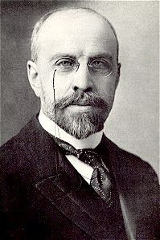
An Ordinary Hero Chapter 17
Here is the secret for a revival, viz.: the instruction of the people in the Bible by the best men of the church. This is worth tons of sermons on civic righteousness and reforms, and no end of so-called evangelistic campaigns and religious “movements,” which have so much of man in them and so little of God.
– James M. Gray (1851 – 1935)

Slide 14
An Ordinary Hero Chapter 17
Two big lessons from the life of Jehoshaphat:
A generally good life can be seriously tarnished by terrible mistakes if we aren’t careful.
Even if we’ve made some terrible mistakes, persistently trying to please the Lord can lead to some serious blessing.

Slide 15
An Ordinary Hero Chapter 18

Slide 16
An Ordinary Hero Chapter 18
18:1 Jehoshaphat … made a marriage alliance with Ahab.
This may have been J.’s biggest mistake – one which had lasting consequences.

Slide 17
An Ordinary Hero Chapter 18
18:2-3 This chapter recounts Jehoshaphat’s alliance with Ahab and Ahab’s death in battle.
We went over this when we looked at 1 Kings 22.
Find it online at horizoncentral.net or dckoso.wordpress.com

Slide 18
An Ordinary Hero Chapter 19

Slide 19
An Ordinary Hero Chapter 19
19:1-3 Should you help the wicked and love those who hate the Lord?
J. no doubt felt committed because of that marriage alliance.
He now felt a personal obligation to fight Ahab’s enemies.

Slide 20
An Ordinary Hero Chapter 19
19:1-3 We may be reminded of what Paul said to the Corinthian church,
1 Corinthians 15:33-34 ³³Do not be deceived: “Bad company ruins good morals.” ³⁴Wake up from your drunken stupor, as is right, and do not go on sinning. For some have no knowledge of God. I say this to your shame.

Slide 21
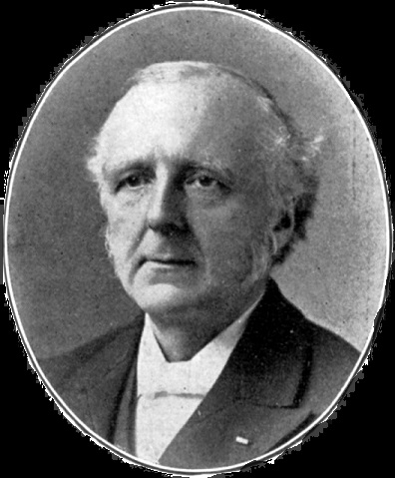
An Ordinary Hero Chapter 19
There is a great tendency in the present day to boast in the closeness with which we can approach the world without injury … The real difficulty lies away back in our want of engagedness with Christ. It is of little use to find fault with the outward, as long as the heart is wayward.
– F. B. Meyer (1847 – 1929)

Slide 22
An Ordinary Hero Chapter 19
19:4-11 J. reminds the judges that they are standing in God’s place and doing God’s work.
A fair and just legal system is serious business. It was a huge responsibility and J. took it seriously.

Slide 23
An Ordinary Hero Chapter 19
Two big lessons from the life of Jehoshaphat:
A generally good life can be seriously tarnished by terrible mistakes if we aren’t careful.
Even if we’ve made some terrible mistakes, persistently trying to please the Lord can lead to some serious blessing.

Slide 24
An Ordinary Hero Chapter 20

Slide 25
An Ordinary Hero Chapter 20
20:2 “the sea” would be the Dead Sea in this case.
20:3-4 Everything J. does here is perfect.
20:5-12 He then leads his people in a humble prayer, praying God’s promises back to him.

Slide 26
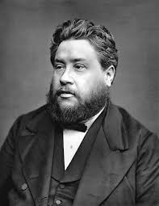
An Ordinary Hero Chapter 20
I like to plunge my hand into the promises – then I find myself able to grasp with a grip of determination the mighty faithfulness of God!
– Charles Spurgeon (1834 – 1892)

Slide 27
An Ordinary Hero Chapter 20
When I am overwhelmed and outnumbered by the enemy, when it looks like I am going down in certain defeat, it is great to know that God is fighting for me. I don’t need to strive or panic. I don’t need to turn and run. I just stand in my position of my relationship with Jesus Christ and He will fight for me and He will win.
– Chuck Smith (1927 – 2013)

Slide 28
An Ordinary Hero Chapter 20
20:15 This may be J.’s life verse – key to his whole life story.

Slide 29
An Ordinary Hero Chapter 20
20:27-30 There is a remarkably happy ending for J. and the Kingdom of Judah.
20:31-32 And here is the summary of his life, he “did not turn aside … doing what was right in the sight of the Lord.”
By God’s grace, Jehoshaphat gets good reviews.

Slide 30
An Ordinary Hero Chapter 20
20:32 His sins could be overlooked because of his faith.
Even as we look back on the cross of Christ, OT saints could look forward to what God was going to do to redeem them.
The Faith of OT Saints Our Faith

Slide 31
An Ordinary Hero Chapter 20
20:33 The high places, however, were not taken away.
Wait, I thought they were! What about 17:6?
It only takes one generation for a nation to fall away.

Slide 32
An Ordinary Hero Chapter 20
20:35-37 Because you have joined with Ahaziah...
Ahab’s son was almost as a big a jerk as his father.
There was no blessing to be found associating with him.

Slide 33
An Ordinary Hero Chapter 20
May we have grace to-day, in the remembrance of this text, to bless the Lord for ships broken at Ezion-geber … let us not envy the more successful, nor murmur at our losses as though we were singularly and specially tried. Like Jehoshaphat, we may be precious in the Lord's sight, although our schemes end in disappointment.
– Charles Spurgeon (1834 – 1892)

Slide 34
An Ordinary Hero Conclusions

Slide 35
An Ordinary Hero Conclusions
Jehoshaphat’s Failures:
  Marriage alliance with Ahab
  Uniting with Ahab to fight Ahab’s enemies
  Alliance with Ahaziah son of Ahab.
Notice the pattern. All of these involve Ahab.

Slide 36
An Ordinary Hero Conclusions
Jehoshaphat’s Successes:
  He rejected idolatry and sought the Lord.
  He sent out teachers to teach the Book of the Law.
  He reminded judges to judge righteously.
  He prayed God’s promises.
  He encouraged trust in and the worship of the Lord.
Notice the pattern. All of these express his deep faith in the God of Israel.

Slide 37
An Ordinary Hero Conclusions
To highlight one failure: Marriage Alliance with Ahab
2 Corinthians 6:14-16 ¹⁴Do not be unequally yoked with unbelievers. For what partnership has righteousness with lawlessness? Or what fellowship has light with darkness?
¹⁵What accord has Christ with Belial? Or what portion does a believer share with an unbeliever? ¹⁶What agreement has the temple of God with idols? For we are the temple of the living God…

Slide 38
An Ordinary Hero Conclusions
In Jehoshaphat’s case this unequal yoking exhibited itself in three different ways:
    In the marriage of his son.
    In battle, fighting alongside Ahab.
    In business, building ships to engage in trade.

Slide 39
An Ordinary Hero Conclusions
We will be wise to avoid similar circumstances:
    In marriage – perhaps the most obvious.
    In battle – or taking up causes that are popular, but not dear to the heart of God.
    In business – where partnerships and alliances can lead us into compromising situations.

Slide 40
An Ordinary Hero Conclusions
To highlight two successes:
  He sent out teachers to teach the Book of the Law.
  He prayed God’s promises.

Slide 41
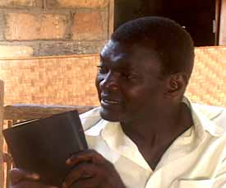
An Ordinary Hero Conclusions
To quote our friend, Dr. Nupanga Weanzana,
Jesus’ final command to his disciples was not only that they should ‘make disciples of all nations’, but also that they should be involved in ‘teaching them to obey everything I have commanded you’ (Matt 28:20). The … church preaches, but too often does not teach.

Slide 42
An Ordinary Hero Conclusions
To quote our friend, Dr. Nupanga Weanzana,
There is much talk of revival and sometimes the impression is given that revival comes suddenly like a roll of thunder. But the Bible, and the example of Jehoshaphat’s teachers who took with them the Book of the Law of the Lord (17:9), show that teaching is the best way to bring revival to a nation.

Slide 43
An Ordinary Hero Conclusions
Also, God’s promises are found in God’s Word, the Bible.
We will not be able to pray God’s promises as J. did if we are unfamiliar with them from Scripture.
How will we learn them?
Through diligent study of God’s Word.

Slide 44
An Ordinary Hero Conclusions
Two big lessons from the life of Jehoshaphat:
A generally good life can be seriously tarnished by terrible mistakes if we aren’t careful.
Even if we’ve made some terrible mistakes, persistently trying to please the Lord can lead to some serious blessing.
Faithfulness to the Lord and faithfulness to his Word are pretty much the same thing.

