Slide 1
Division and Decline
2 Chronicles 10 – 12

Slide 2
Division and Decline Introduction

Slide 3
Division and Decline Introduction
When people refuse to submit to God, the inevitable result is a complicated mess.
For example, the church in Corinth was a continuous source of trouble for the Apostle Paul.
Their lack of maturity led to various forms of disobedience and division.

Slide 4
Division and Decline Introduction
The same was true in the days of Rehoboam son of Solomon.
In his day the kingdom was divided.
Sadly, it never fully recovered.
The decline continued until both halves of the kingdom ended in defeat and exile.

Slide 5
Division and Decline Introduction
Rehoboam, however, did finally repent.
If there is a positive lesson in these chapters, it may simply be that repentance is always possible.

Slide 6
Revolt 2 Chronicles 10

Slide 7
Revolt 2 Chronicles 10
10:7 The older men may have been familiar with Solomon’s advice from Proverbs 15:1.

Slide 8
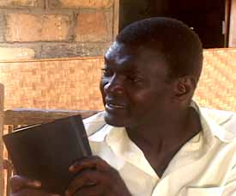
Revolt 2 Chronicles 10
In Africa the ‘elders’, as older people are affectionately called, are considered a source of wisdom and their word is listened to with attention. … Too many conflicts between young and old … start because young people do not want to listen to the wise advice of older people.
– Nupanga Weanzana, Faculté de Théologie Evangélique de Bangui

Slide 9
Revolt 2 Chronicles 10
In choosing whose counsel to follow, Rehoboam might not only have listened to age.
Not everyone who is old is also wise.
His father’s counselors at least had some political or leadership experience.
And Solomon ruled a peaceful and prosperous kingdom.

Slide 10
Revolt 2 Chronicles 10
Those his own age would have had little or no experience.
Unfortunately, there is no quick or easy way to obtain experience or attain maturity.

Slide 11
Revolt 2 Chronicles 10
Still, we should not lay too much of the blame for the divided kingdom on Rehoboam.
The reasons for the division are more complex than that.
This is clear in both the books of Kings and Chronicles.

Slide 12
Revolt 2 Chronicles 10
Solomon laid a heavy burden on the people with all his building projects.
Jeroboam rebelled first against Solomon, then Rehoboam and finally against the Lord, leading his tribes into idolatry.
Rehoboam failed to heed wise counsel.

Slide 13
Revolt 2 Chronicles 10
Take Away Points:
God’s people need to remain unified, but that unity will most easily be the result of everyone being submitted to God.
The more people drift away from him, the harder it is to maintain unity.

Slide 14
Retreat 2 Chronicles 11

Slide 15
Retreat 2 Chronicles 11
This chapter gives us a good example of how the Bible differs from other ancient beliefs about nations and their gods.
Choosing the right god does not always lead to victory.
Sometimes the God of Israel encourages a retreat.

Slide 16
Retreat 2 Chronicles 11
Rehoboam and his army were ordered to retreat from fighting against the idolatrous northern kingdom.
The priests and Levites then retreated to the security of Judah and Jerusalem.

Slide 17
Retreat 2 Chronicles 11
Paul makes an interesting point about division in the Corinthian church. Sometimes it is inevitable.
See 1 Corinthians 11:17-19.
In other words, division is preferable to unified disobedience.
This may be why God allowed the division of the kingdom.

Slide 18
Retreat 2 Chronicles 11
Take Away Point:
Sometimes the only way even to achieve peace is to decide to stop fighting.

Slide 19
Retreat 2 Chronicles 11
Once again,
God’s people need to remain unified, but that unity will most easily be the result of everyone being submitted to God.
In this case obedience was preferable to unity.
Both were not possible.

Slide 20
Repentance & Renewal 2 Chronicles 12

Slide 21
Repentance & Renewal 2 Chronicles 12
12:1 Have you seen this kind of behavior in your own life?
In times of trouble, we remain close to God, begging for his mercy. Once we are strong, we promptly forget the Lord.

Slide 22
Repentance & Renewal 2 Chronicles 12
12:7 Consider 2 Chronicles 7:14.
If my people who are called by my name humble themselves, and pray and seek my face and turn from their wicked ways, then I will hear from heaven and will forgive their sin and heal their land.

Slide 23
Repentance & Renewal 2 Chronicles 12
12:8 Recall what Jesus said in Matthew 11:28-30.

Slide 24
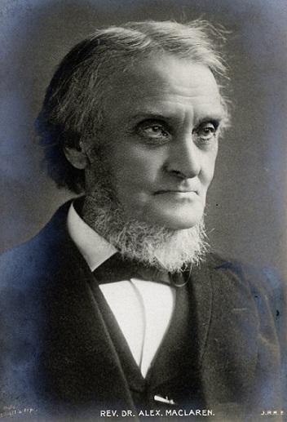
Repentance & Renewal 2 Chronicles 12
Liberty is unrestrained power to do what we ought … To do as we like is not freedom, but bondage to self … and he is a fool who conceits himself free because he lets his inferior self have its full swing, and hustles his better self into bondage.
– Alexander Maclaren

Slide 25
Repentance & Renewal 2 Chronicles 12
12:12 Rehoboam’s reign was not a good one overall. Nonetheless, his repentance was valuable in God’s sight.

Slide 26
Repentance & Renewal 2 Chronicles 12
12:13-16 At least we can say this about Rehoboam’s reign:
It could have been a lot worse!

Slide 27
Repentance & Renewal 2 Chronicles 12
Take Away Point:
Rehoboam played a major role in the division and decline of Israel and Judah.
Still, when he repented, God received that repentance as genuine.
As long as you are still breathing, repentance is possible.

Slide 28
Division and Decline Summary

Slide 29
Division and Decline Summary
Dividing a kingdom is a messy business. There is plenty of blame to go around. Once again,
Solomon laid a heavy burden on the people with all his building projects.
Jeroboam rebelled first against Solomon, then Rehoboam, and finally against the Lord, leading his tribes into idolatry.
Rehoboam failed to heed wise counsel.

Slide 30
Division and Decline Summary
Rehoboam also has to take a good deal of responsibility for the decline of godliness in Judah.
He turned away from the Lord – and did not seek him.
Though he personally repented he could not undo all the damage that was done.

Slide 31
Division and Decline Summary
We read a sad summary of Rehoboam’s life in 12:14.

Slide 32
Division and Decline Summary
Rehoboam was a self-willed, godless king who, like some other kings, learned nothing by experience. His kingdom was nearly wrecked at the very beginning of his reign, and was saved much more by the folly of his rival than by his own wisdom.
– Alexander Maclaren

Slide 33
Division and Decline Conclusions

Slide 34
Division and Decline Conclusions
Take Away Points:
God’s people need to remain unified, but that unity will most easily be the result of everyone being submitted to God.
The more people drift away from him, the harder it is to maintain unity.

Slide 35
Division and Decline Conclusions
Take Away Points:
Sometimes the only way to even achieve peace is to decide to stop fighting.
Obedience and unity will not always both be possible.
Choose obedience. Division is preferable to unified disobedience.

Slide 36
Division and Decline Conclusions
Take Away Points:
As long as you are still breathing, repentance is possible.

Slide 37
Division and Decline Conclusions
In the New Testament, the Corinthian church was characterized by disunity and disobedience.
Paul encourages them to overcome their problems through repentance and a healthy dose of love.

Slide 38
Division and Decline Conclusions
The best place to start may be the place Rehoboam never seemed to go.
12:14 And he did evil, for he did not set his heart to seek the Lord.
What if we start by setting our hearts to seek the Lord?

