Slide 1
Dedicating the Temple
1 Kings 8

Slide 2
Dedicating the Temple Introduction

Slide 3
Dedicating the Temple Introduction
God is infinite.
God is eternal.
God is holy beyond the grandest, most wide-ranging limits of our intelligence or spiritual perception.

Slide 4
Dedicating the Temple Introduction
If we are ever going to interact with God, it is going to have to be on his terms.
When God had Moses and his men construct the tabernacle and all of its furnishings, he was communicating that he wanted to interact with his people.

Slide 5
Dedicating the Temple Introduction
At the time of the scene we look at today, Jerusalem had already been the capital of Israel for over forty years.
Solomon has now finished building the temple that David his father had hoped to build.

Slide 6
Dedicating the Temple Introduction
To dedicate it, he organized a national worship service – possibly the most important in Israel’s history.
This gathering officially recognized Jerusalem as the place where the God of Israel had chosen to set his name.

Slide 7
Bringing In the Ark 8:1-11

Slide 8
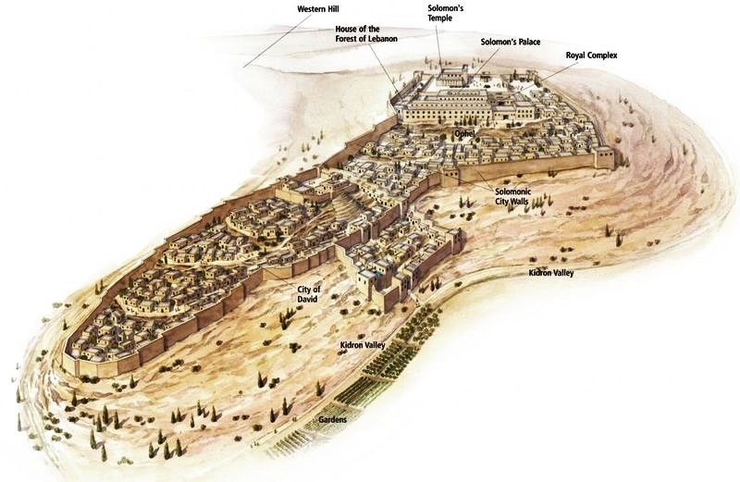
Jerusalem in the Time of Solomon – from the ESV Study Bible

Slide 9
Bringing In the Ark 8:1-11
8:2 at the feast in the month Ethanim
This would have been the Feast of Tabernacles which takes place in the Fall.

Slide 10
Bringing In the Ark 8:1-11
8:6 the inner sanctuary … the Most Holy Place
The Temple was set up much like the Tabernacle had been only much larger.
There was an outer court, a Holy Place and a Most Holy Place or “Holy of Holies,” in which was the ark.

Slide 11
Bringing In the Ark 8:1-11
8:9 there was nothing in the ark except the two tablets
Originally the ark also contained the pot of manna and Aaron’s rod that budded.
  See Exodus 16:33-34 and Hebrews 9:4.
For some reason, they were no longer there.
Later the ark itself was lost.

Slide 12
Bringing In the Ark 8:1-11
8:10 The cloud (sometimes called the Shekinah or “dwelling, inhabiting”) was a symbol of the presence of God.
It also appeared in the days of Moses (Exodus 40:34-35).
The prophet Ezekiel had a vision of the cloud departing (Ezekiel 10:3-4, 18-19; 11:23).
The glory of the Lord left the temple as the nation came under God’s judgment.

Slide 13
Solomon Blesses the Lord 8:12-21
Solomon’s focus is on the fact that the Lord has been faithful to fulfill all his promises – to David and to the nation.

Slide 14
Solomon’s Prayer 8:22-53

Slide 15
Solomon’s Prayer 8:22-53
8:22-26 Solomon begins his prayer by declaring God’s faithfulness back to him.
God, of course, knows that he is faithful.
We need to say it even if he doesn’t need to hear it.
That is really true of all prayer.

Slide 16
Solomon’s Prayer 8:22-53
8:27-30 The king admits that any temple built on earth would be inadequate.
God’s presence is there not because the temple is so great, but because he desires to dwell among his people.

Slide 17

Solomon’s Prayer 8:22-53
Many people have narrow concepts of God. … Solomon … wasn’t thinking that this house would contain God. God is so much bigger. But this house would be a place where the people could meet with God.
– Chuck Smith (1927 – 2013)

Slide 18
Solomon’s Prayer 8:22-53
8:31-53 The rest of the prayer can be divided into seven distinct requests.
Some Bibles divide them into paragraphs.

Slide 19
Solomon’s Prayer 8:22-53
8:31-32 A prayer for righteous judgment
8:33-34 When the people endure defeat because of sin
8:35-36 When there is drought because of sin
8:37-40 When there is famine or some other problem
8:41-43 When a foreigner (non-Israelite) prays
8:44-45 If the people must go into battle
8:46-53 If the people are carried away captive

Slide 20
Solomon Blesses the People 8:54-61
Again, notice the focus on God’s faithfulness.

Slide 21
Solomon Blesses the People 8:54-61
8:59 as each day requires
More literally, “a matter (or thing) of a day in its day”

Slide 22
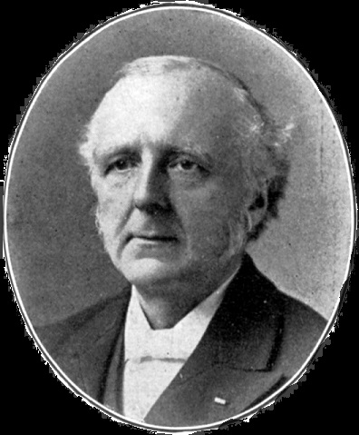
Solomon Blesses the People 8:54-61
As we stand on the hill-top in the morning and look across the valley of the coming day, its scenes are too closely veiled in heavy-hanging mists for us to specify all our requests. … God will suit his help to each requirement. As the moment arrives “the thing” will be there.
– F. B. Meyer

Slide 23
Solomon Blesses the People 8:54-61
8:59 Jesus taught us to pray, “Give us this day our daily bread.”
We can trust our Father to meet our needs as needs arise.

Slide 24
Solomon Blesses the People 8:54-61
8:60 that all the peoples of the earth may know that the Lord is God; there is no other.
Solomon is prayer this nearly 1000 years before Jesus.
He still saw that the Lord was no local or tribal deity.

Slide 25
Sacrifices and a Feast 8:62-66

Slide 26
Sacrifices and a Feast 8:62-66
8:66 they … went to their homes joyful and glad of heart for all the goodness that the Lord had shown
The people had come from many miles, but their worship continued all the way home.

Slide 27
Sacrifices and a Feast 8:62-66
8:66 When our worship is over, let’s make it a point to continue in an attitude of thankfulness and joy.
Let the feast continue beyond our gathering together.

Slide 28
Dedicating the Temple Conclusions

Slide 29
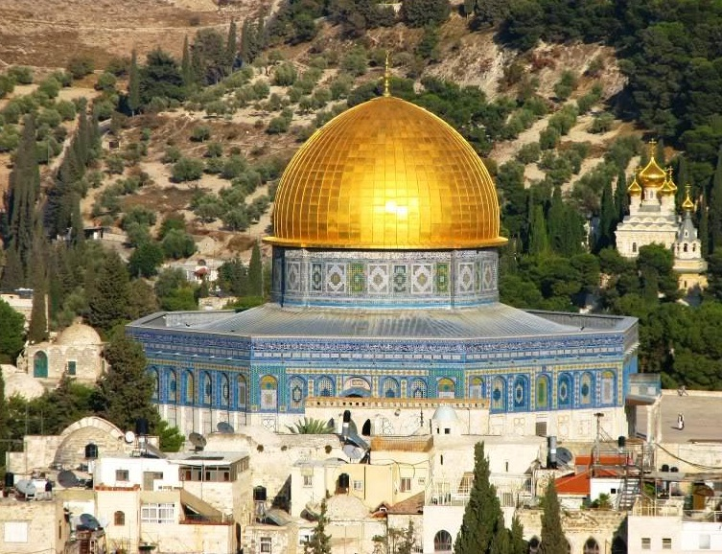
Dedicating the Temple Conclusions
The Temple Mount is presently occupied by the Dome of the Rock Mosque.
There is a movement among very orthodox Jews to build a new Temple.

Slide 30
Dedicating the Temple Conclusions
The books of Daniel and Revelation indicate that a Temple needs to be rebuilt.
These books speak of a Temple complete with sacrifices in the end times.

Slide 31
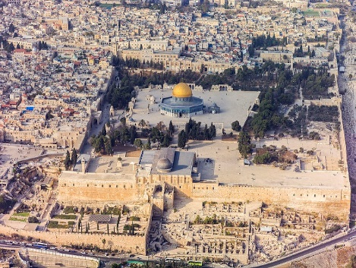
Dedicating the Temple Conclusions
A compromise solution might work.
There is plenty of room on the top of the hill for both a Temple and the Dome of the Rock.

Slide 32
Dedicating the Temple Conclusions
In the eternal New Jerusalem there will not be a Temple.
  See Revelation 21:22-23.

Slide 33
Dedicating the Temple Conclusions
Jesus referred to his body as a temple that he would raise up in three days.
  See John 2:18-22

Slide 34
Dedicating the Temple Conclusions
At the present time, we Christians are the dwelling place of God here on earth.
Our temple needs to be dedicated to him.
  1 Corinthians 6:19-20
  2 Corinthians 6:16

Slide 35
Dedicating the Temple Conclusions
Just as Solomon’s Temple was filled with the glory of God, we need to be filled with the Holy Spirit.
Ephesians 5:15-21
Let’s close by praying for that continual filling.

