Slide 1
The Wisdom of Solomon
1 Kings 3-4

Slide 2
The Wisdom of Solomon Introduction

Slide 3
The Wisdom of Solomon Introduction
Before we start, think of at least three areas in which:

Slide 4
The Wisdom of Solomon Introduction
Before we start, think of at least three areas in which:
  Your knowledge seems inadequate.

Slide 5
The Wisdom of Solomon Introduction
Before we start, think of at least three areas in which:
  Your knowledge seems inadequate.
  Your responsibilities are larger than your abilities.

Slide 6
The Wisdom of Solomon Introduction
Before we start, think of at least three areas in which:
  Your knowledge seems inadequate.
  Your responsibilities are larger than your abilities.
  Other people depend on you and it’s not at all clear that giving it your best is going to be enough.

Slide 7
The Wisdom of Solomon Introduction
Solomon was relatively young when he took over the throne from his father David.
He wasn’t sure he could handle the job.
These chapters show us how he grew into his role.

Slide 8
Solomon’s Marriage 3:1

Slide 9
Solomon’s Marriage 3:1
A purely political marriage.
Normal for kings. Not a great precedent for Solomon.
The gods of his foreign wives eventually led to his downfall.

Slide 10
Solomon’s Prayer 3:2-9

Slide 11
Solomon’s Prayer 3:2-9
3:2-3 High places The Canaanites formerly offered sacrifices to their gods on hilltops.
The Israelites now used them to sacrifice to the Lord.

Slide 12
Solomon’s Prayer 3:2-9
3:5 The Lord appeared … in a dream
Does God still use dreams today?
We shouldn’t rule it out. God uses dreams in the Bible.
Perhaps the key is that Solomon wasn’t looking for it of asking for it.
If we insist upon God speaking to us this way, we can easily be led off track.

Slide 13
Solomon’s Prayer 3:2-9
3:7 a little child Solomon was a young man, but not a child in the literal sense. Possibly in his 20s.
Dream or not, Solomon’s request was a good one.
It showed the rightness of his priorities.

Slide 14
Solomon’s Prayer 3:2-9
3:9 an understanding mind Literally, “a hearing heart”
Hearing, especially in the Old Testament, is characterized by obedience.

Slide 15
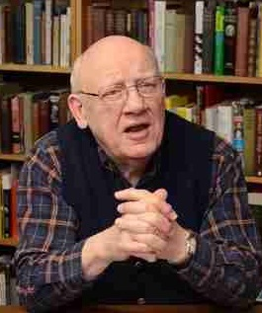
Solomon’s Prayer 3:2-9
When the Lord speaks to us, it’s not that we might study and pass judgment on what He said, but that we might obey it. An understanding heart has insight and exercises discernment … It knows what is real and what is artificial, what is temporal and what is eternal.
– Warren Wiersbe

Slide 16
God’s Answer 3:10-15

Slide 17
God’s Answer 3:10-15
God’s answer to Solomon is a perfect example of what Jesus said in the Sermon on the Mount.
  See Matthew 6:31-33

Slide 18
Wisdom as Discernment 3:16-28

Slide 19
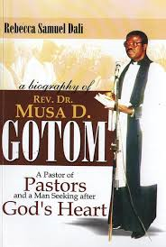
Wisdom as Discernment 3:16-28
Musa Gotom, of the Theological College of Northern Nigeria comments,
We tend to leave [prostitutes] to the mercy of those who use them … and of the police who arrest them from time to time. Yet in God’s program, they are as important as any other citizen.

Slide 20
Wisdom as Discernment 3:16-28
Musa Gotom, of the Theological College of Northern Nigeria comments,
Yes, their deeds are evil, but their lives are precious. … Solomon was a judge not only for the righteous but also for the unrighteous. In the same way, the church is called to minister to all.

Slide 21
Wisdom as Discernment 3:16-28
Solomon showed God’s heart by seeking justice for the least of the citizens of his kingdom.
He showed God’s wisdom by seeing how to make a decision in a very difficult case.

Slide 22
Wisdom in Entrusting Others 4:1-19

Slide 23
Wisdom in Entrusting Others 4:1-19
Sometimes wisdom is displayed in knowing how to properly delegate responsibilities.
We have to know not only what to do or how to do things, but what we cannot do ourselves.
That’s the kind of wisdom Solomon is showing here.

Slide 24
Wisdom as Administrative Skill 4:1-19
Solomon’s government ran more efficiently because he surrounded himself with other wise and capable people.
His son Rehoboam will not do that and the kingdom will be divided as a result.

Slide 25
Wisdom as Ruling Well 4:20-28

Slide 26
Wisdom as Ruling Well 4:20-28
Solomon proved to be a wise and capable ruler.
The nation was strengthened as a result.
Solomon was faithful in carrying out his duties.
God was faithful in blessing his chosen nation.

Slide 27
Wisdom as Vast Knowledge 4:29-34

Slide 28
Wisdom as Vast Knowledge 4:29-34
4:29 breadth of mind Literally, “breadth of heart.”
Solomon had a all-inclusive understanding. He was knowledgeable on a wide variety of topics.

Slide 29
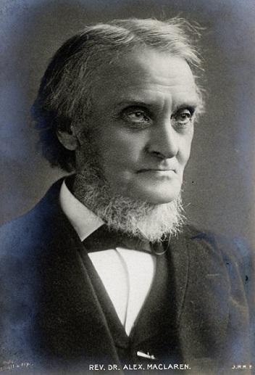
Wisdom as Vast Knowledge 4:29-34
In Solomon we see exemplified the normal relation between religion and intellectual power and learning. Judge, artist, scientist, and all other thinkers and students, draw their power from God, and should use it for Him …
– Alexander Maclaren (1826-1910)

Slide 30
Wisdom as Vast Knowledge 4:29-34
Solomon’s example is a rebuke to those narrow-minded Christians who look askance at men of learning, letters, or science, as well as to those still more narrow-minded men of intellectual ability who think that science and religion must be sworn foes. If our religion is what it should be, it will widen our understanding all round.
– Alexander Maclaren (1826-1910)

Slide 31
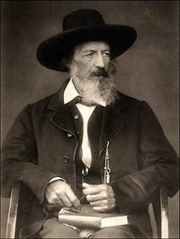
Wisdom as Vast Knowledge 4:29-34
Let knowledge grow from more to more, But more of reverence in us dwell;
That mind and soul, according well, May make one music as before,
But vaster.”
– Alfred, Lord Tennyson (1826-1910)

Slide 32
The Wisdom of Solomon Conclusions

Slide 33
The Wisdom of Solomon Conclusions
Solomon recognized early in his reign that he needed more wisdom than he naturally had.
Solomon was teachable.
Solomon craved wisdom and had a deep desire to learn.

Slide 34
The Wisdom of Solomon Conclusions
David was a soldier.
Solomon was a scholar. We don’t hear of him going to war.
Both of them liked to write songs.
Both of them enjoyed the favor of their people.

Slide 35
The Wisdom of Solomon Conclusions
God answered his prayer.
We will eventually read Proverbs, Ecclesiastes and the Song of Solomon, all attributed to this king.
We also have two Psalms written by him.
  Psalm 72
  Psalm 127

Slide 36
The Wisdom of Solomon Conclusions
Still, in Christ we have one greater than Solomon.
  See Matthew 12:42

Slide 37
The Wisdom of Solomon Conclusions
Remember what we talked about earlier?
Areas in which:
  Your knowledge seems inadequate.
  Your responsibilities are larger than your abilities.
  Other people depend on you and it’s not at all clear that giving it your best is going to be enough.

Slide 38
The Wisdom of Solomon Conclusions
James recommended we pray for wisdom.
    See James 1:5
And he then explains what it looks like.
  See James 3:13-18
Paul’s prayer for the Philippian church is very much a prayer for wisdom – without ever using the word.
  See Philippians 1:9-11

