Slide 1
Samuel’s Farewell
1 Samuel 12

Slide 2
Samuel’s Farewell Introduction

Slide 3
Samuel’s Farewell Introduction
Samuel is the last of the judges.
He is also the first of the prophets. He begins his prophetic role when Saul takes over as king.
This chapter is Samuel’s final speech to the nation.

Slide 4
Samuel’s Farewell Introduction
From this point on his role is less public.
We might consider this his retirement speech as he leaves his public life to take on a more private ministry.
From this point on King Saul will lead Israel.

Slide 5
Samuel’s Integrity 12:1-5

Slide 6
Samuel’s Integrity 12:1-5
Samuel’s spent his entire life in full view of the nation, beginning from his childhood.
Even at this late point, no one could accuse him of wrongdoing.

Slide 7
Samuel’s Integrity 12:1-5
12:5 The Lord is witness against you The people plainly admitted that there was no ground for their discontent with Samuel’s leadership.
They simply wanted a king.

Slide 8
The Lord’s Faithfulness 12:6-11

Slide 9
The Lord’s Faithfulness 12:6-11
The Lord was faithful even though the people were not.
In rejecting Samuel, they were really rejecting the Lord.
  See 1 Samuel 8:4-7

Slide 10
The Lord’s Faithfulness 12:12-18

Slide 11
The Lord’s Faithfulness 12:12-18
Israel’s real need was not a king, but greater loyalty to God.
In the days of the judges, they never knew how God was going to help them or who God was going to call.
They needed to exercise their faith.
They needed to trust the Lord.

Slide 12
The Lord’s Faithfulness 12:12-18
Just as they could see their enemies (12:12), they wanted to be able to see their king.
They wanted to walk by sight more than by faith.

Slide 13
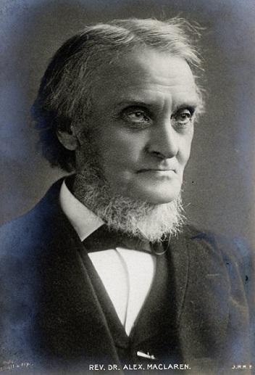
The Lord’s Faithfulness 12:12-18
Our dim eyes cannot see the realities of the invisible world, and so we cleave to the illusions of the visible, which, at their best, are but shadows of the real, and are often made, by our weak hearts, its rival and substitute.
– Alexander Maclaren (1826 – 1910)

Slide 14
The Lord’s Faithfulness 12:12-18
Nonetheless, if they would be faithful, God would continue to help them.
If they would be unfaithful, God’s hand would be against both the nation and their king.

Slide 15
The Lord’s Faithfulness 12:12-18
God will later use their desire for a king.
He will promise David, the next king, that a descendant of his will reign forever upon his throne over Israel.
We will see that in 2 Samuel 7.

Slide 16
Samuel’s Commitment 12:19-25

Slide 17
Samuel’s Commitment 12:19-25
12:19 The people’s commitment will prove to be shallow.
Israel would continue to struggle with idolatry long after this.

Slide 18
Samuel’s Commitment 12:19-25
12:19 It seems they fear the possibility of punishment more than they fear God.
In this they are like Simon the Magician in Acts 8 who asked for prayer after Peter called him out for his deceitful heart.

Slide 19
Samuel’s Commitment 12:19-25
The real penitent will press the closer to the forgiving Father, and his cry will be for purity even more than for pardon.
– Alexander Maclaren (1826 – 1910)

Slide 20
Samuel’s Commitment 12:19-25
12:20-22 Samuel encourages them to be faithful and to not turn away to empty things.
At some level, we all probably struggle with giving God our complete loyalty and obedience.

Slide 21

Samuel’s Commitment 12:19-25
Built within each man is the desire to worship. I’ve got to worship something. And if I choose not to worship God, I will end up worshiping something else … And anything I worship except God is going to leave me empty, because it can’t fill the void that is within me.
– Chuck Smith (1927 – 2013)

Slide 22
Samuel’s Commitment 12:19-25
12:23-25 Even so, God’s heart was truly always to bless his people.
I believe his heart is also to bless us, but we do have to pledge our loyalty to him from this day forward.

Slide 23
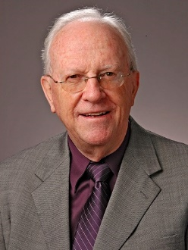
Samuel’s Commitment 12:19-25
Samuel related to the people that God would bless them in spite of their wrong choice if they would only be steadfast in their obedience from this point on. The past could not be undone but their future was untainted and could be devoted to the Lord.
– Eugene H. Merrill (1934 – )

Slide 24
Samuel’s Commitment 12:19-25
12:23-25 Let’s also not miss Samuel’s commitment to pray for the people and to teach them the ways of the Lord.
Is it possible God is calling some of us to a deeper ministry of intercessory prayer or to lead and teach others his ways?

Slide 25
Samuel’s Farewell: Conclusions

Slide 26
Samuel’s Farewell: Conclusions
Something the people did wrong:
They wanted to live more by sight than by faith.
Sometimes we do not get the precise visible assurances of God’s faithfulness and love for us that we desire.
Are we willing to be OK with that?

Slide 27
Samuel’s Farewell: Conclusions
Something else the people did wrong:
They wanted a human leader they could trust, a king, rather than trusting the Lord more completely.
In the final analysis, human government will inevitably fail us, God will not.

Slide 28
Samuel’s Farewell: Conclusions
Something Samuel did right:
He lived a life of total integrity.
Can we decide right now to do the same?

Slide 29
Samuel’s Farewell: Conclusions
Something else Samuel did right:
He prayed for the people and committed to teach them even after they rejected his leadership.
Again, is it possible God is calling some of us to a deeper ministry of intercessory prayer or to lead and teach others his ways?

Slide 30
Samuel’s Farewell: Conclusions
Walk by faith not by sight. (2 Corinthians 5:7)

Slide 31
Samuel’s Farewell: Conclusions
Walk by faith not by sight. (2 Corinthians 5:7)
Trust in the Lord more than in human leadership.

Slide 32
Samuel’s Farewell: Conclusions
Walk by faith not by sight. (2 Corinthians 5:7)
Trust in the Lord more than in human leadership.
Live a life of complete integrity.

Slide 33
Samuel’s Farewell: Conclusions
Walk by faith not by sight. (2 Corinthians 5:7)
Trust in the Lord more than in human leadership.
Live a life of complete integrity.
Devotion to prayer.

Slide 34
Samuel’s Farewell: Conclusions
Walk by faith not by sight. (2 Corinthians 5:7)
Trust in the Lord more than in human leadership.
Live a life of complete integrity.
Devotion to prayer.
Commitment to faithful biblical teaching – whether as a teacher or one being taught.

