Slide 1
Gideon: 12 Lessons
Judges 6 – 8

Slide 2
Gideon Introduction

Slide 3
Gideon Introduction
What do we remember about Gideon?

Slide 4
Gideon Introduction
What do we remember about Gideon?
He was the one who started the practice of putting Bibles in hotel rooms.

Slide 5
Gideon Introduction
What do we remember about Gideon?
He was the one who started the practice of putting Bibles in hotel rooms.
He was the one who defeated a great big army with a band of 300 men.

Slide 6
Gideon Introduction
Gideon is one of the heroes of the faith listed in Hebrews 11.
We can pull at least 12 lessons out of his life.
Some of them are positive – that is, Gideon is a positive example.
Gideon also gives us a couple of lessons in “what not to do.”

Slide 7
Gideon

Slide 8
Gideon Judges 6:1-10

Slide 9
Gideon Judges 6:1-10
Lesson 1
Even when the mess you’re in is entirely your own fault, it still pays to cry out to God.

Slide 10
Gideon Judges 6:11-18

Slide 11
Gideon Judges 6:11-18
Lesson 2
When God wants to get something done in this world, he normally calls people to do it.

Slide 12
Gideon Judges 6:11-18
Lesson 3
He will be with us as we go, therefore the results depend on his strength, not ours.

Slide 13
Gideon Judges 6:19-32

Slide 14
Gideon Judges 6:19-32
Lesson 4
Take time out to worship the Lord.

Slide 15
Gideon Judges 6:19-32
Lesson 5
True worship usually involves sacrifice.

Slide 16
Gideon Judges 6:19-32
Lesson 6
Destroy all your idols – and all their altars.

Slide 17
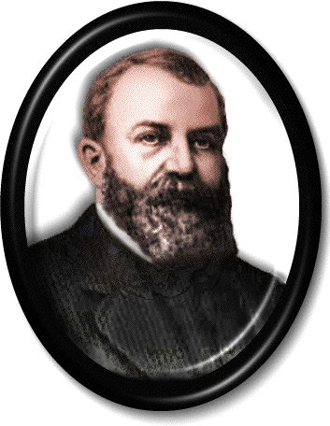
Gideon Judges 6:19-32
Some British pastors were talking about inviting evangelist D.L. Moody to their city for an outreach.
One man asked, “Why must it be Moody? Does D.L. Moody have a monopoly on the Holy Spirit?”

Slide 18
Gideon Judges 6:19-32
One of the others replied, “No, but it’s evident that the Holy Spirit has a monopoly on D.L. Moody.”
God wants a monopoly on us.

Slide 19
Gideon Judges 6:33-40

Slide 20
Gideon Judges 6:33-40
Lesson 7
Really, you probably don’t need “fleeces” to determine God’s will.

Slide 21
Gideon Judges 6:33-40
Lesson 7
Really, you probably don’t need “fleeces” to determine God’s will.
God’s will was already clear.
Gideon may have done this to strengthen his faith.
He may also have used it as evidence to convince others.

Slide 22
Gideon Judges 7:1-8

Slide 23
Gideon Judges 7:1-8
Lesson 8
God can always win – and he doesn’t need a big army.

Slide 24
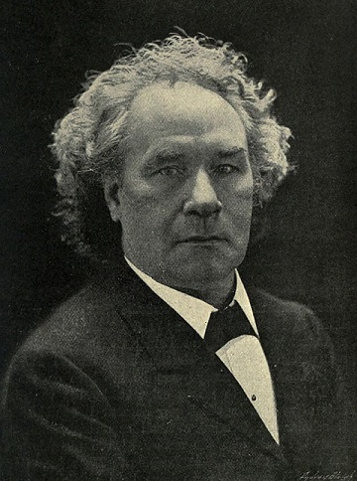
Gideon Judges 7:1-8
I have heard Him say, "Where two or three are gathered together in My name there am I."
I have heard Him say, "One shall chase a thousand, and two shall put ten thousand to flight,"
But I never heard Him say, "You must get more men, or I cannot do this work; you must increase the human forces, or the Divine energy will not be equal to the occasion.”
– Joseph Parker (1830-1902)

Slide 25
Gideon Judges 7:9-25

Slide 26
Gideon Judges 7:9-25
Lesson 9
Even when God is with you and assures you of victory, you still have to fight the battle.

Slide 27
Gideon Judges 7:9-25
Lesson 9
Even when God is with you and assures you of victory, you still have to fight the battle.
See Ephesians 6:10-12

Slide 28
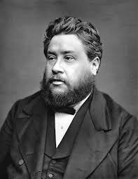
Gideon Judges 7:9-25
“If God loves you he will use you either for suffering or service; and if he has given you peace you must now prepare for war. Will you think me odd if I say that our Lord came to give us peace that he might send us out to war?”
– Charles Spurgeon (1834-1892)

Slide 29
Gideon Judges 8:22-28

Slide 30
Gideon Judges 8:22-28
Lesson 10
Right after you experience a great victory, look out!

Slide 31
Gideon Judges 8:22-28
Lesson 10
Right after you experience a great victory, look out!
Ephod = A garment that partially covers – like an apron or a poncho.
The high priest wore one that had a breastpiece holding the Urim and Thummim.
Gideon may have wrongly taken on priestly functions.

Slide 32
Gideon Judges 8:29-32

Slide 33
Gideon Judges 8:29-32
Lesson 10(a)
Especially for guys: No matter how much of a big shot you ever get to be, you don’t get all the girls.

Slide 34
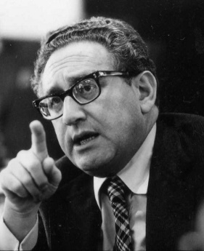
Gideon Judges 8:29-32
“Power is the ultimate aphrodisiac.”
– Henry Kissinger (1923 – )

Slide 35
Gideon Judges 8:29-32
Lesson 11
Whatever you do, finish well. Please. Finish well.

Slide 36
Gideon Judges 8:33-35

Slide 37
Gideon Judges 8:33-35
Lesson 12
Leave a legacy of positive influence that outlasts you.

Slide 38
Gideon 12 Lessons

Slide 39
Gideon 12 Lessons
Even when the mess you’re in is entirely your own fault, it still pays to cry out to God.
When God wants to get something done in this world, he normally calls people to do it.
He will be with us as we go, therefore the results depend on his strength, not ours.

Slide 40
Gideon 12 Lessons
Take time out to worship the Lord.
True worship usually involves sacrifice.
Destroy all your idols – and all their altars.

Slide 41
Gideon 12 Lessons
Really, you probably don’t need “fleeces” to determine God’s will.
God can always win – and he doesn’t need a big army.
Even when God is with you and assures you of victory, you still have to fight the battle.

Slide 42
Gideon 12 Lessons
Right after you experience a great victory, look out!
  10(a). Especially for guys: No matter how much of a big shot you ever get to be, you don’t get all the girls.
Whatever you do, finish well. Please. Finish well.
Leave a legacy of positive influence that outlasts you.

