Slide 1
The Cycle
Judges 1 – 2

Slide 2
The Cycle Introduction

Slide 3
The Cycle Introduction
A quick look back to Joshua:
Joshua 1:7-9
Joshua 23:1-13

Slide 4
The Cycle Introduction
The Lord waited hundreds of years to give Israel this land.
They were now in it.
It was time to possess their possessions.
So what happened?

Slide 5
The Cycle

Slide 6
The Cycle
Judges 1 Snatching defeat from the jaws of victory.

Slide 7
The Cycle
2:1-5 The angel of the Lord can be a pre-incarnate appearance of Jesus Christ.
He speaks in the first person as God, “I brought you up … So now I say…”

Slide 8
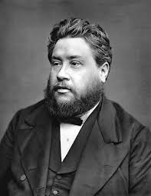
These people were deceived as to the depth and sincerity of their own feelings. Doubtless they reckoned themselves choice penitents when they were only cowardly tremblers, labouring under impressions which were as useless as they were transient.
– Charles Spurgeon (1834-1892)

Slide 9
The Cycle
2:6-10 “And the people served the Lord all the days of Joshua …”
Notice how long Joshua’s influence lasted.
This is his legacy.
He had a big influence on the nation, but his influence eventually died out.

Slide 10
The Cycle
2:6-10 “And the people served the Lord all the days of Joshua …”
This did not have to happen.
Israel only needed more people like Joshua.
We should pray, determine and work toward the goal that we would be like him.

Slide 11
The Cycle
Judges 2:11 “The people … did what was evil in the sight of the Lord.”
This is a repeated line in Judges (7x). Also see:
  Judges 3:7
  Judges 3:12
  Judges 4:1
  Judges 6:1
  Judges 10:6
  Judges 13:1

Slide 12
The Cycle
Judges 2:11-21 This passage describes the cycle of sin and repentance that Israel fell into.

Slide 13
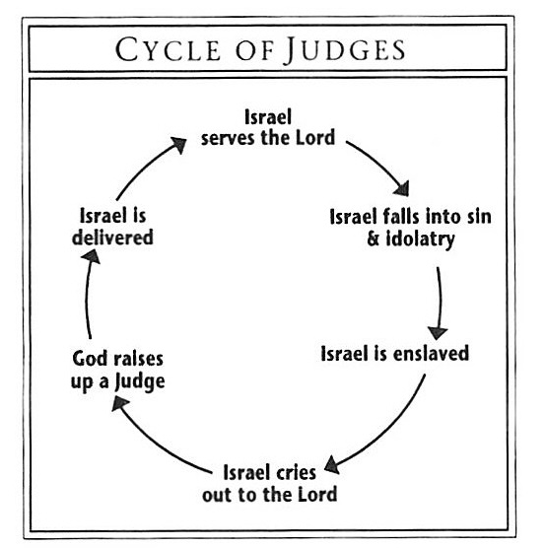
The Cycle
From:
Ryrie Study Bible

Slide 14
The Cycle
It was more than a cycle; it was a downward spiral.
The disobedience and idolatry kept taking Israel further away from God and deeper into sin and sadness.
By the end of the book, Israel will violate its covenant with God in almost every possible way.

Slide 15
The Cycle
Reasons for the cycle – for Israel and for us:
  Self-deception
  Compromise
  Fear
  Fatigue

Slide 16
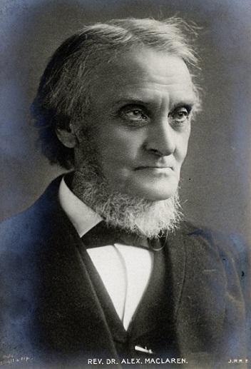
The Cycle
We have all unconquered ‘Canaanites’ in our hearts, and amity with them is supreme folly and crying wickedness … Israel was in some respects conquered by Canaanites … Let us take care that we are not overcome by our inward foes, whom we fancy we have subdued and can afford to treat leniently.
– Alexander Maclaren (1826-1910)

Slide 17
The Cycle
Reasons for the cycle – for Israel and for us:
  Self-deception – We think we have sin beat when we really don’t
  Compromise – We may need to compromise on our rights, but we dare not compromise our responsibilities. We may secretly love our sin.
  Fear – We fear we won’t win; we fear God won’t triumph in the end.
  Fatigue – fighting battles is hard, so we make excuses.

Slide 18
Breaking the Cycle

Slide 19
Breaking the Cycle
Step 1 is to remember God’s goodness, because this will help us see our sin in its true light.
Step 2 is to see our sin in all its ugliness.
Step 3 is to truly hate it.
Step 4 is to do whatever it takes to overcome it with God’s help. This is the wisest thing we can possibly do and gives evidence of a serious fear of God.

Slide 20
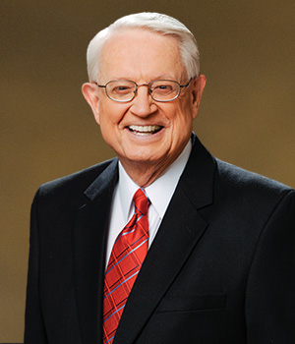
Memory is a gift. Remembering the past teaches us countless lessons about how to live today. The Israelites forgot. They did not remember the miraculous events that brought them to their land or the covenant that united them to their God.
– Charles Swindoll (1934-

Slide 21
But God did not forget His covenant—and because of His great love for His people, He disciplined His sinful children so that they might return to Him.
– Charles Swindoll (1934-

Slide 22
Breaking the Cycle
The fear of the Lord:
  Proverbs 1:7
  Proverbs 8:13
  Proverbs 9:10
  Proverbs 10:27
  Proverbs 14:26-27
  Proverbs 15:33
  Proverbs 19:23
  Proverbs 22:4

Slide 23
Breaking the Cycle
We have sinned.
We have strayed from God’s path.
There are consequences for our actions.
Christ is our Deliverer.
1 Corinthians 15:56-57
Romans 6:11-14

Slide 24
Breaking the Cycle
The deliverers in the book of Judges are all imperfect.
Their deliverance is woefully short-lived.
We have Christ, a flawless and eternal Deliverer.

Slide 25
Breaking the Cycle
The deliverers in Judges only rescued Israel from the consequences of their sin – the trouble they were in at the moment.
Christ delivers us from sin’s power. We are not only forgiven, not only helped, but transformed.

Slide 26
Breaking the Cycle
Covenant relationship
God is always faithful, people may not be.
Despite human failure, the story goes on. We’re still early in the Bible and God made it all work.
There may be reasons for our failure, but none of them fully excuse our guilt.

Slide 27
Breaking the Cycle
The victories of sin are never irreversible.
When evil appears to triumph, we only need to remember the cross.
God uses imperfect people – even failures.
Think of Hebrews 11:32-33

