Slide 1
Slaves Forever
Deuteronomy 15:12-18

Slide 2
Background on Loving God

Slide 3
Background on Loving God
The Greatest Commandment, see Deuteronomy 6:4-9.
Loving Obedience, see Deuteronomy 10:12-13.

Slide 4
Background on Slavery in the Bible

Slide 5
Background on Slavery in the Bible
Very unlike American slavery
Regarding kidnapping, see Exodus 21:16.
Regarding escaped slaves, see Deuteronomy 23:15-16.

Slide 6
Background on Slavery in the Bible
Very unlike American slavery
Kidnapping punishable by death.
Escaped slaves must be protected.
Today’s passage: Deuteronomy 15:12-18

Slide 7
Service as an Expression of Love

Slide 8
Service as an Expression of Love
15:12 Mandatory freedom
15:13-14 Mandatory provision
15:15 Remembrance of past slavery
  Remembrance of God’s redemption

Slide 9
Service as an Expression of Love
15:16-18 The choice of service or freedom
The commandments were written on the doorpost in Deuteronomy 6.
The household was under the authority of God.
The slave’s ear was pierced at the door.
He or she now belonged to the household.

Slide 10
Service as an Expression of Love
The choices were:
  Freedom with separation
  Love with continuing slavery
Such service was perfect freedom.
It was motivated by devotion – an expression of love.

Slide 11
The Loving Service of Jesus

Slide 12
The Loving Service of Jesus
See Philippians 2:7-8

Slide 13
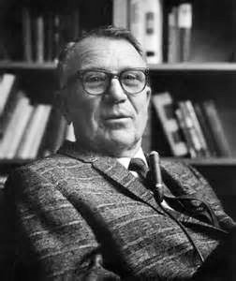
The Loving Service of Jesus
Jesus could have gone out free. He owed no debt of sin; he was no sinner. He had no penalty to pay. But he loved us and gave himself for us.
– J. Vernon McGee

Slide 14
The Loving Service of Jesus
See also Psalm 40:6-8
Literally, “ears you have dug for me”
NKJV = “My ears you have opened.”

Slide 15
The Loving Service of Jesus
Hebrews 10:5-7 takes this passage from a different translation and applies it to Christ.
Also see Isaiah 50:5-6.

Slide 16
The Loving Service of Jesus
Jesus took on a human nature with a human body.
And it led to his crucifixion for you and me.
This was all done in loving, willing obedience.
See Hebrews 5:8.

Slide 17
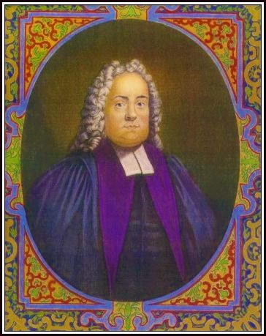
The Loving Service of Jesus
“We are to remember that we are debtors to Divine justice, and have nothing to pay with. That we are slaves, poor, and perishing.
– Matthew Henry (1662 – 1714)

Slide 18
The Loving Service of Jesus
“But the Lord Jesus Christ, by becoming poor, and by shedding his blood, has made a full and free provision for the payment of our debts, the ransom of our souls, and the supply of all our wants.”
– Matthew Henry (1662 – 1714)

Slide 19
Our Response: Slaves Forever

Slide 20
Our Response: Slaves Forever
Let’s listen to Peter, speaking on behalf of the Twelve.
See John 6:66-69

Slide 21

Our Response: Slaves Forever
Bible commentator R.M. Edgar, on Deuteronomy 15:16,
“We are the Lord's slaves after having become the Lord's freemen. He delivers us from the slavery of sin, and then he introduces us to his service …

Slide 22
Our Response: Slaves Forever
Bible commentator R.M. Edgar, on Deuteronomy 15:16,
“And lo, we find it so blessed that we insist on our ears being bored, and our being made his slaves forever. Now obedience is the slavery of love.”

Slide 23
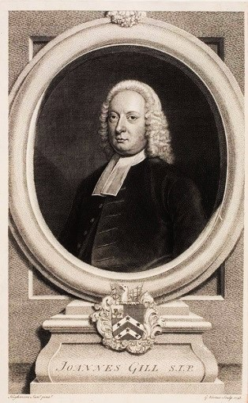
Our Response: Slaves Forever
John Gill (1697 – 1771) on the same verse said,
“This is an emblem of the cheerful and constant obedience of the people of Christ to him their master, flowing from love to him; whom they love above all persons and things, with all their heart and soul.”

Slide 24
Our Response: Slaves Forever
Consider also,
  Paul in Romans 1:1
  James in James 1:1
  Peter in 2 Peter 1:1
  Jude in Jude 1:1
  John in Revelation 1:1

Slide 25
Our Response: Slaves Forever
Characteristics of lifelong service:

Slide 26
Our Response: Slaves Forever
Characteristics of lifelong service:
Our lives are not our own. We belong to the Master and have chosen to stay.
Our primary motivation needs to be love for the Master, not our own needs or desires.

Slide 27
Our Response: Slaves Forever
Characteristics of lifelong service:
Our primary task is obedience to the Master. Our ears are open to him.
Our success will not be determined by standards that we set for ourselves or that the world sets for us.
We will trust the Master for provision and protection.

Slide 28
Our Response: Slaves Forever
As with the master in Deuteronomy 15, Jesus offers us our complete freedom.
His servants do not serve under compulsion.
We are not forced to stay.

Slide 29
Our Response: Slaves Forever
But then we must ask ourselves, “To whom shall we go?”
Do we not love our master and his household?
Are we not well off with him?

Slide 30
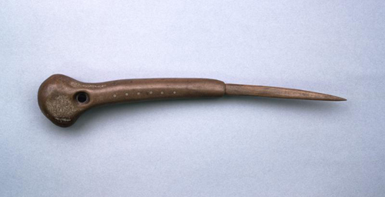
Our Response: Slaves Forever
See Revelation 22:1-5.
The most sensible response we can give to Christ is to make ourselves his slaves forever.

