Slide 1
Sin, a Serpent and a Savior
Numbers 21:4-9

Slide 2
Sin, a Serpent and a Savior Introduction

Slide 3
Sin, a Serpent and a Savior Introduction
Read Numbers 21:4-9

Slide 4
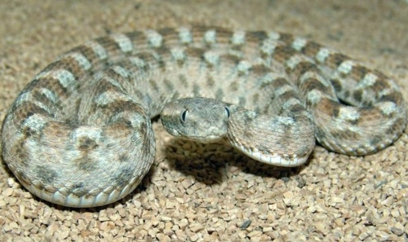
Sin, a Serpent and a Savior
Burton’s Carpet Viper

Slide 5
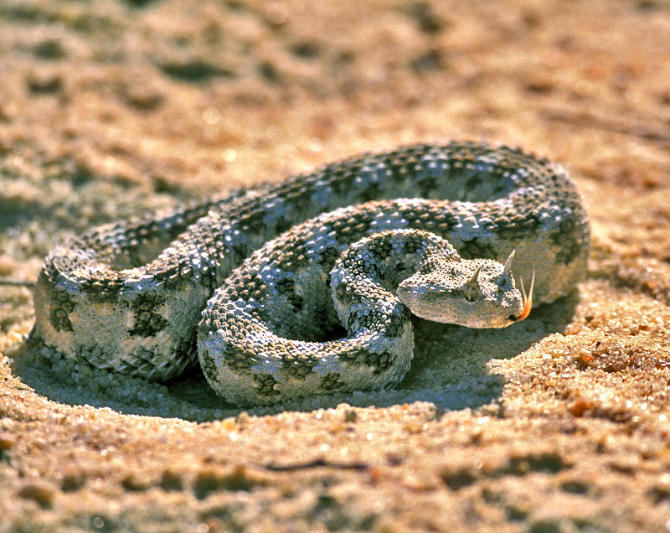
Sin, a Serpent and a Savior
Horned Viper

Slide 6
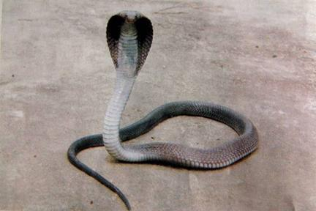
Sin, a Serpent and a Savior
Black Cobra

Slide 7
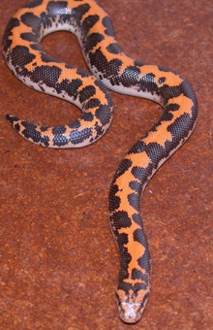
Sin, a Serpent and a Savior
Egyptian Sand Boa
(kills by constriction)

Slide 8
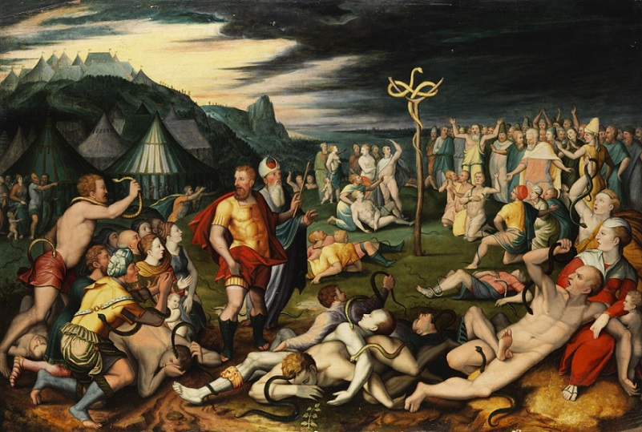
Sin, a Serpent and a Savior
Flemish
17th Century

Slide 9
Sin, a Serpent and a Savior
21:4-5 The complaint is unfair.
God provided them with manna.
He provided water from the rock.
They were discontent, not forsaken.

Slide 10
Sin, a Serpent and a Savior
21:6-7 Their sin had consequences.
The consequences helped them to see their sin.
They ask Moses to intercede.
He did – again.

Slide 11
Sin, a Serpent and a Savior
21:8-9 God provided a remedy.
Faith was required to receive its benefit.

Slide 12
Biblical Context

Slide 13
Biblical Context
Genesis 3:1-19 as background music
2 Kings 18:1-4 as a later development
John 3:14-15 for Christ’s use of the story

Slide 14
The Crisis

Slide 15
The Crisis
The sin itself
  A state of rebellion
  A wrong attitude toward God and others
  Separation from God

Slide 16
The Crisis
Sin’s consequences
  Death by snakebite
  God as an adversary
  Guilt before God

Slide 17
The Crisis
The sinner’s hopeless condition
  A state of physical suffering
  Awareness of guilt
    Not merely a feeling
    Knowledge of facts
  Helplessness in the midst of the crisis.

Slide 18
The Crisis
Sin is the Trojan horse out of which a whole troop of afflictions comes. … [and] it embitters affliction. Guilt makes affliction heavy. A little water is heavy in a lead vessel – and a little affliction is heavy in a guilty conscience.
– Thomas Watson (1620 – 1686)

Slide 19
The Remedy

Slide 20
The Remedy
Moses prayed; God responded.
God gave the remedy.
The remedy was directly related to the affliction.
The remedy required a response.

Slide 21
The Remedy
There was only one choice.
This choice remained the only choice.
No new choices were added.

Slide 22
The Remedy
The bitten Israelite was shut up to the brazen serpent; for the brazen serpent was God’s exclusive remedy for the bitten Israelite. To look anywhere else was to get nothing; to look at God’s provision was to get life.
– C.H. Mackintosh (1820 – 1896)

Slide 23
Christ as Our Remedy

Slide 24
Christ as Our Remedy
Romans 6:23
1 John 2:1-2
2 Corinthians 5:20-21

Slide 25
Sin, a Serpent and a Savior Conclusion

Slide 26
Sin, a Serpent and a Savior Conclusion
The unpopularity of “sin”
  If morals are relative then sin disappears.
  But morals are not relative.
Individual sin and sin in general
  People sin; so what?
  I have sinned.

Slide 27
Sin, a Serpent and a Savior Conclusion
The need to see our need
The need to accept God’s remedy
The superabundant quality of the cure

Slide 28
Sin, a Serpent and a Savior Conclusion
Christ's redemption was so plenteous, that had God willed it, if all the stars of heaven had been peopled with sinners, Christ need not have suffered another pang to redeem them all — there was a boundless value in His precious blood. And, sinner, if there were so much as this, surely there is enough for thee.
– Charles Spurgeon (1834 – 1892)

