Slide 1
Idolatry, etc.
Exodus 32

Slide 2
Idolatry, etc. Introduction

Slide 3
Idolatry, etc. Introduction
We are wired for worship.
When we reject God, we quickly find an idol to fill the gap in our meaningless existence.
(Not everyone agrees.)

Slide 4
Idolatry, etc. Introduction
For example, last month:
Peter Watson, The Age of Atheists: How We Have Sought to Live Since the Death of God
Mitchell Stephens, Imagine There’s No Heaven: How Atheism Helped Create the Modern World

Slide 5
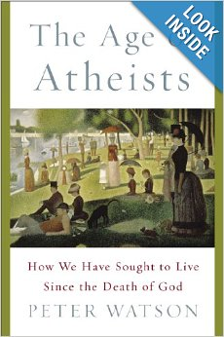
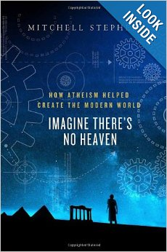
Idolatry, etc. Introduction

Slide 6
Idolatry, etc. Introduction
The topic was addressed recently by Emma Green, an associate editor at The Atlantic.
She entitled her article, The Intellectual Snobbery of Conspicuous Atheism.
She looks at Peter Watson’s book, The Age of Atheists.

Slide 7
Idolatry, etc. Introduction
Her conclusion:
“Watson implies that full engagement with the project of being human in the modern world leads to atheism, and that's just not true.”
Most people simply refuse to accept the idea that there is nothing out there bigger and more important than themselves.

Slide 8
Idolatry, etc. Introduction
She elaborates,
“The Western world in particular is probably less religious than it was 150 years ago … But if the age of atheism started in 1882 as Watson claims, most people still haven't caught on.”
According to a 2012 Pew Forum study, only 6% of the population claims to be “atheist” or “agnostic.”

Slide 9
Idolatry, etc. Introduction
We are wired for worship.
When we reject God, we quickly find an idol to fill the gap in our meaningless existence.

Slide 10
Idolatry, etc. Outline

Slide 11
Idolatry, etc. Outline
Idolatry comes to us easily. 32:1-6
Idolatry is a rejection of God. 32:7-14
Idolatry must be rejected. 32:15-24
Idolatry has devastating effects. 32:25-35

Slide 12
I. Idolatry comes to us easily. 32:1-6

Slide 13
I. Idolatry comes to us easily. 32:1-6
Having already forgotten God, the Israelites needed something to fill the gap.
They were exposed to exactly this kind of religion back in Egypt, so it was a natural choice.
Apis, an ancient Egyptian god.

Slide 14
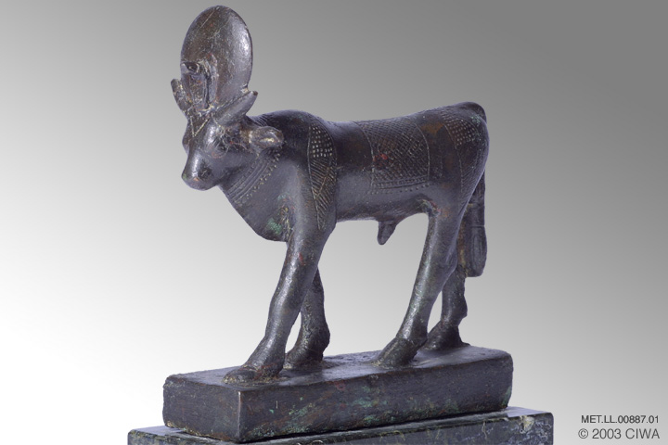
I. Idolatry comes to us easily. 32:1-6

Slide 15
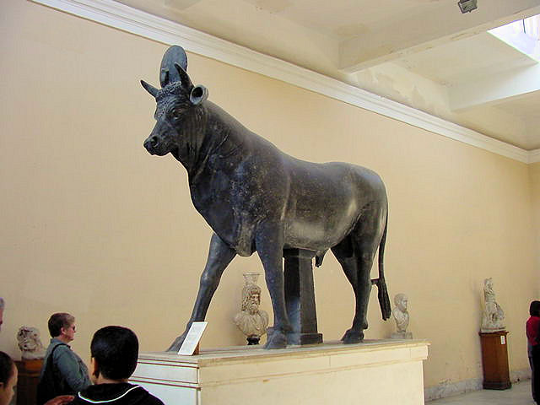
I. Idolatry comes to us easily. 32:1-6

Slide 16
I. Idolatry comes to us easily. 32:1-6
Each of us inwardly longs to be devoted to something or someone bigger than ourselves.
That devotion gives our lives purpose and meaning.
A meaningless life equals a worthless life.

Slide 17
I. Idolatry comes to us easily. 32:1-6
We are wired for worship.
When we reject God, we quickly find an idol to fill the gap in our meaningless existence.

Slide 18
II. Idolatry is a rejection of God. 32:7-14

Slide 19
II. Idolatry is a rejection of God. 32:7-14
32:7 “your people, whom you brought up”
The people rejected God, so he rejected them.
Compare with v.1. No reference to God.
32:9-11 Moses did not seek glory for himself, but rather sought the glory of God.

Slide 20
II. Idolatry is a rejection of God. 32:7-14
32:11-14 As Moses intercedes, he doesn’t focus on the character or faithfulness of the people.
He focuses on:
  The character of God.
  The faithfulness of God.
  The mercy of God.
  The promises of God.

Slide 21
II. Idolatry is a rejection of God. 32:7-14
When our prayers are grounded in our trust in God, there is no limit to what we can ask.
We can rest in his mercy, his care, his faithfulness.
If, like Moses, our goal is to glorify God, why shouldn’t we pray big bold prayers like these?

Slide 22
III. Idolatry must be rejected. 32:15-24

Slide 23
III. Idolatry must be rejected. 32:15-24
Moses’s view of idolatry is comparable to God’s.
God won’t stand for it, so neither will Moses.
As for Aaron, well …

Slide 24
III. Idolatry must be rejected. 32:15-24
Q: What if we say the statue or image is only a symbol?
In other words, not revered by the worshiper?
A: That might be a great theory if only it would work.
In practice, idols quickly become sacred objects.
God knows this, thus we have the Second Commandment.

Slide 25
III. Idolatry must be rejected. 32:15-24
We may also have false concepts of God.
Aaron’s golden calf gave the people an incorrect, or unbiblical, concept of the God of Israel.
“These are your gods …” (32:4)
“… a feast to the Lord.” (32:5)

Slide 26
III. Idolatry must be rejected. 32:15-24
Incorrect or unbiblical concepts of God will replace our devotion to the true God.
That’s part of why God revealed himself to us in Jesus.
See 1 John 5:20-21.

Slide 27
IV. Idolatry has devastating effects. 32:25-35

Slide 28
IV. Idolatry has devastating effects. 32:25-35
Most of us will find this passage shocking.
Killing with the sword and killing with a plague seem harsh.

Slide 29
IV. Idolatry has devastating effects. 32:25-35
Two conclusions:
The God of the Bible must be spiteful, unjust and cruel.
Our perception of the awful consequences of idolatry – or even sin in general – is inadequate.

Slide 30
IV. Idolatry has devastating effects. 32:25-35
John Steinbeck’s Lennie, in Of Mice and Men:
Lennie is very powerful, but lacks intelligence.
He strives to be gentle and kind, but fails, and in reality is extremely destructive.
He repeatedly kills things and causes disaster.
Then he is defenseless, helpless to undo the damage.

Slide 31
IV. Idolatry has devastating effects. 32:25-35
In the spiritual sense, we are all like Lennie.
Our sin can wreak spiritual havoc on ourselves and the world around us.
We’re are usually too stupid, too earthbound, to fully grasp the spiritual consequences.

Slide 32
IV. Idolatry has devastating effects. 32:25-35
Since all sin is ultimately against God, he has the best perspective on the damage that it does.
And we all have a lot to learn.

Slide 33
IV. Idolatry has devastating effects. 32:25-35
We can also learn from Moses’s example of intercession.
Combining 32:11-14 with 32:30-34 makes a very instructive study on the topic.

Slide 34
IV. Idolatry has devastating effects. 32:25-35
32:30 Moses wanted to make atonement for the sins of the people.
That was more than even Moses could accomplish.

Slide 35
Idolatry, etc. Summary and Conclusions

Slide 36
Idolatry, etc. Summary and Conclusions
We are wired for worship.
When we reject God, we quickly find an idol to fill the gap in our meaningless existence.

Slide 37
Idolatry, etc. Summary and Conclusions
We’ve seen that:
Idolatry comes to us easily.
Idolatry is a rejection of God.
Idolatry must be rejected.
Idolatry has devastating effects.

Slide 38
Idolatry, etc. Summary and Conclusions
We’ve also seen Moses as an intercessor par excellence.
He focused on God’s glory, his mercy and his promises.
He had faith in God’s character when the character of the people he was praying for was obviously flawed.
He prayed that God would forgive their sin.

Slide 39
Idolatry, etc. Summary and Conclusions
Finally, Moses expresses his willingness to give his own life for the sins of the people. (32:31-32)
Moses has an adequate concept of sin, but God still refuses his offer.
Paul expressed the same sentiment in Romans 9:1-3.

Slide 40
Idolatry, etc. Summary and Conclusions
Moses wasn’t able to die for others.
Paul wasn’t able to die for others.
They saw the need, but none of us can make that sacrifice.
None of us, that is, except Jesus.
See Romans 5:6-9.

