Slide 1
Saved by the Blood
Exodus 12

Slide 2
Saved by the Blood Introduction

Slide 3
Saved by the Blood Introduction
The night Jesus was betrayed, he celebrated the Passover with his disciples.
He implemented the New Covenant in his blood, and slowly but surely made his way to the cross at Golgotha.

Slide 4
Saved by the Blood Introduction
Christ died in conjunction with the Passover.
That was no coincidence.
It was part of God’s eternal plan.

Slide 5
Saved by the Blood Introduction
Key Thought:
“And when I see the blood, I will pass over you…”
– From Exodus 12:13

Slide 6
Outline of Exodus 12

Slide 7
Outline of Exodus 12
The Passover Lamb 12:1-6
Saved by the Blood 12:7-13
Unleavened Bread 12:14-20
Moses Instructs the People 12:21-28
Death of the Firstborn 12:29-32
The Exodus from Egypt 12:33-42
Ongoing Remembrance 12:43-51

Slide 8
I. The Passover Lamb 12:1-6

Slide 9
I. The Passover Lamb 12:1-6
12:3, 6 The lamb was selected beforehand.
12:5 The lamb had to be without blemish.
See 1 Peter 1:17-20

Slide 10
II. Saved by the Blood 12:7-13

Slide 11
II. Saved by the Blood 12:7-13
Again, that Key Thought:
“And when I see the blood, I will pass over you…”
– From Exodus 12:13
Again, see 1 Peter 1:19

Slide 12
III. Unleavened Bread 12:14-20

Slide 13
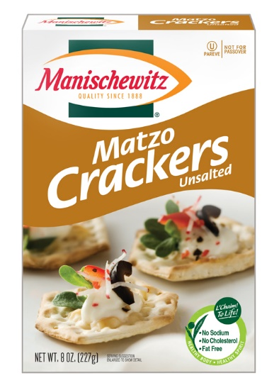
III. Unleavened Bread 12:14-20

Slide 14
III. Unleavened Bread 12:14-20
Leaven in the Bible is often associated with various kinds of sin, corruption or insincerity.
In Luke 12:1, Jesus warned his disciples of “the leaven of the Pharisees, which is hypocrisy.”
Hear what Paul says in 1 Corinthians 5:7-8.

Slide 15
IV. Moses Instructs the People 12:21-28

Slide 16
IV. Moses Instructs the People 12:21-28
12:28 The people obeyed.
Faith needs to express itself in obedient action.
In this case the people had to sacrifice the lamb and apply the blood to their doorways.
Fun Fact:
In doing so they were outlining the shape of a cross.

Slide 17
IV. Moses Instructs the People 12:21-28

Slide 18
IV. Moses Instructs the People 12:21-28

Slide 19
IV. Moses Instructs the People 12:21-28

Slide 20
IV. Moses Instructs the People 12:21-28

Slide 21
IV. Moses Instructs the People 12:21-28

Slide 22
V. Death of the Firstborn 12:29-32

Slide 23
V. Death of the Firstborn 12:29-32
Around the time Moses was born, the Pharaoh had commanded the Israelites to kill their male children.
He was afraid of a future uprising by his slaves.
After many years of holding them in bondage, this Pharaoh is practically chasing the Israelites out.
It’s amazing what a series of plagues can do.

Slide 24
V. Death of the Firstborn 12:29-32
Persistent rebellion in the face of God leads to a complete breaking of a person’s will at the hands of God.
We can willingly bend to him now, or forcibly be broken by him later.
It’s easier to willingly bend.

Slide 25
VI. The Exodus from Egypt 12:33-42

Slide 26
VI. The Exodus from Egypt 12:33-42
The same Egyptians who had enslaved the Israelites for so long now feared them and shared their own possessions with them.
How quickly things can change.

Slide 27
VII. Ongoing Remembrance 12:43-51

Slide 28
VII. Ongoing Remembrance 12:43-51
12:46 “you shall not break any of its bones”
See John 19:31-36.

Slide 29
VII. Ongoing Remembrance 12:43-51
Foreigners (strangers) were allowed to take part in the Passover celebration, as long as they were willing to fully identify themselves with the people of Israel.
This calls into question the person who claims to be a Christian, but does not fully identify with the church.

Slide 30
Saved by the Blood Concluding Thoughts

Slide 31
Saved by the Blood Concluding Thoughts
The God of the New Testament is the God of the Old Testament. He hasn’t changed.
He is slowly but surely fulfilling his perfect plan.

Slide 32
Saved by the Blood Concluding Thoughts
The Israelites were saved out of bondage and death in Egypt by taking advantage of God’s appointed means for their rescue – the sacrificed Passover lamb.
They were to sacrifice the lamb, apply the blood to the doorway of their houses and then enjoy the Passover meal.
The feast of Passover has been continually celebrated by the Jews to this day.

Slide 33
Saved by the Blood Concluding Thoughts
Christ is our Passover Sacrifice. See John 1:29.
He is the way God has provided for our rescue from the bondage of sin and death.
His death – the shedding of his blood – is our perfect sacrifice.
Then, as our resurrected Lord, he provides us with a continual feast.

Slide 34
Saved by the Blood Concluding Thoughts
Alexander Maclaren (1826 – 1910) observed,
“We feast on Christ when the mind feeds on Him as truth, when the heart is filled and satisfied with His love, when the conscience clings to Him as its peace, when the will esteems the ‘words of His mouth more than’ its ‘necessary food,’ when all desires, hopes, and inward powers draw their supplies from Him, and find their object in His sweet sufficiency.”

Slide 35
Saved by the Blood Concluding Thoughts
“And when I see the blood, I will pass over you…”
– From Exodus 12:13
Therefore, we must accept Christ’s sacrifice as our one and only hope and make him the focus of our faith.

