Slide 1
Living in a World Where We Don’t Belong
1 Peter

Slide 2
1 Peter: Introduction

Slide 3
1 Peter: Introduction
We’ve all had the rewarding and instructive experience of feeling like you don’t fit in.
If we are in a given place just for fun, then perhaps it’s no big deal.
We leave and move on to a different situation.
On a deeper level, however, not belonging can raise some valid questions.

Slide 4
1 Peter: Introduction
Not belonging forces us to struggle with our identity: who we are compared with who we are expected to be by those around us.
If we change at all, is it simple compromise in order to conform?
Or is it because our own imperfections demand some level of growth or change?

Slide 5
1 Peter: Introduction
It forces us to grapple with our purpose for being in a particular place.
If I am in a situation in order to have my own needs met, then feeling like I don’t belong presents an insurmountable problem.
On the other hand, if God has me someplace, then I’m there on an assignment.
My job is to fulfill certain responsibilities in that situation on behalf of my Master.

Slide 6
1 Peter: Introduction
Peter sees Christians, including himself, as people living in a world where they don’t belong.
We are “sojourners and pilgrims,” people staying someplace for time, but who are really strangers or foreigners, living in a place without the full rights of citizens.
This world is not our ultimate destination, not our final home.

Slide 7
1 Peter: Introduction
So the instructions Peter gives us are intended to help us make the most of life here in this temporary location – and prepare us for our ultimate destination.
How does our Master expect us to behave and what does He expect us to accomplish?
How can we make the greatest impact on those around us while we are here.

Slide 8
1 Peter: Introduction
But realistically, those around us will often not appreciate the fact that we are different.
They may even treat us badly as a result.
They may say or do things just to highlight the fact that we aren’t playing their game – a game in which they get to make the rules.
As a result we feel alienated, left out, unappreciated by world with conflicting values – a world disconnected from Jesus Christ.

Slide 9
1 Peter: Introduction
How are we supposed to respond to all this?
We know that Jesus ultimately will rule, but He’s not ruling and reigning yet.
The game the world is playing isn’t over.
The answers are not always easy, but Peter does at least offer answers – and we will read these answers today.

Slide 10
Peter, the Author of the Letter

Slide 11
Peter, the Author of the Letter
Simon Peter was one of the original twelve apostles of Jesus Christ.
His name is close to the Greek word for “rock” and would have sounded to people very much like American name “Rocky,” sounds to us.
We may see several variations of his names in the Bible: Simon, Simeon, Peter and Cephas – the last being a Hebraic version of Peter.

Slide 12
Peter, the Author of the Letter
Along with James and John the sons of Zebedee, Peter was among the closest friends of Jesus and seems to have taken an early leadership role among Christ’s disciples.
Yet at the time of Jesus’s trials and death, after promising Him that he would never deny Him, Peter did exactly that.
He denied even knowing Jesus.

Slide 13
Peter, the Author of the Letter
Jesus reinstated him after His resurrection in a moving conversation that took place along the Sea of Galilee.
  See John 21:15-19.
From this point on, Peter resumed a very visible and active role.
In Acts 2, on the day of Pentecost, he gave the church’s first public sermon and as a result 3000 people believed.

Slide 14
Peter, the Author of the Letter
We see more of Peter in the early chapters of Acts, in Jerusalem, Samaria and then along the Mediterranean coast in Joppa and Caesarea.
There he preached the gospel to a house full of Romans and saw these Gentiles come to faith in Christ and receive the Holy Spirit.
This was totally unexpected at that time.

Slide 15
Peter, the Author of the Letter
In Acts 15 he is part of the decision to allow Gentiles into the full fellowship of believers without requiring total conversion to Judaism.
Peter is then missing from the rest of Acts as Luke, the author, focuses on the missionary journeys of Paul.
Peter shows up again in the letters.

Slide 16
Peter, the Author of the Letter
In Paul’s letters, he mentions Peter as being in Syrian Antioch and also in Corinth in Greece.
So we know he had a fairly extensive travelling ministry of some kind.
This letter we call 1 Peter is addressed to believers in several Roman provinces that would all be located in northern or central Turkey today.

Slide 17
The Letter’s Original Recipients

Slide 18
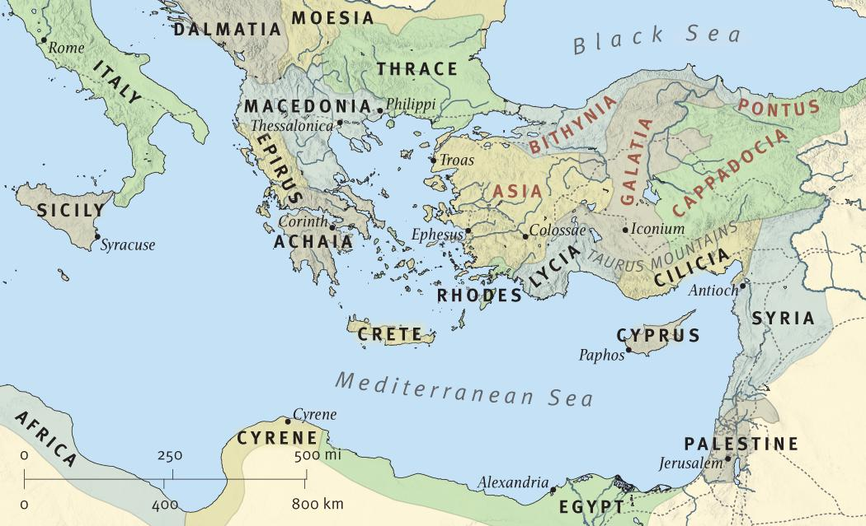
The Letter’s Original Recipients

Slide 19
The Letter’s Original Recipients
Very likely Peter ministered in these areas.
The churches included in such a wide stretch would have been diverse.
They would have included both Jews and Gentiles and people from various walks of life.
Some were highly cultured; others were simple, somewhat tribal people who turned to Christ from the rawest forms of paganism.

Slide 20
The Time of the Letter

Slide 21
The Time of the Letter
Peter probably wrote this letter somewhere toward the end of his life.
Church history tells us that he died in Rome in the persecutions under Nero – who died himself in 68 A.D.
This puts both 1 & 2 Peter somewhere safely in the early or middle 60s.
Persecution was only just beginning and not yet very severe, even in Rome itself.

Slide 22
A Few Facts

Slide 23
A Few Facts
Matthew, John and Peter are the only 3 of the original 12 apostles to write NT books.
Of all the writings in the New Testament, this letter has proportionately the most Old Testament quotations.
Some form of the word “suffer” appears 15 times in the letter.
Every chapter speaks of suffering in some way.

Slide 24
The Topics of the Letter

Slide 25
The Topics of the Letter
The Reality of Our Salvation
The Nature of Our Sanctification – living holy lives in an unholy world.
Living Orderly Lives – in a world that doesn’t live by our Lord’s standards
The Certainty of Christ’s Return
Willingness to Suffer Well – whether criticism, hardship or all out persecution for our faith.

Slide 26
About the Letter

Slide 27
About the Letter
Bible scholar Edmund P. Clowney, has described 1 Peter in this way:
“Peter’s pastoral letter encourages us by instructing us. Our deepest needs drive us to our deepest beliefs. What hope do we have? Peter proclaims Jesus Christ, our sure hope now and for ever.

Slide 28
About the Letter
“Throughout his letter he grounds our hope in the reality of what God has done and will yet do for us through Christ. The apostle is a witness, not just to what Jesus did and said while he was in his fishing-boat or in his house, but to the meaning of Christ’s life, death, resurrection, and ascension.”
  (from The Message of 1 Peter: The Way of the Cross)

Slide 29
About the Letter
Chuck Smith says this:
The theme of the book is suffering.
The Christians were now undergoing increasingly intense suffering and needed to be instructed and encouraged in light of this suffering.
They needed to understand that suffering is a normal part of the Christian life and that it was a way to relate to the suffering of Jesus, which Peter had witnessed personally.

Slide 30
The Lessons of the Letter: A Summary

Slide 31
The Lessons of the Letter: A Summary
Christians should persevere in faith, even while suffering persecution.
We should be full of hope, for we will surely enjoy an eternal salvation that will become completely visible at Christ’s return.
We are already enjoying God’s saving promises here and now – all thanks to the death and resurrection of Jesus Christ.

Slide 32
A Few Key Verses
We’ll keep these up here as we read through the whole letter in just a bit.

Slide 33
A Few Key Verses
A Salvation Prophesied Beforehand 1:10-12
Desire the Pure Milk of the Word 2:1-3
A Proper Use of Our Freedom 2:15-17
Be Ready to Give a Defense 3:15-16
The End Is Near 4:7-8
Use Your Spiritual Gifts 4:10-11
Humble Yourselves Before God 5:6-7

Slide 34
Life Lessons from 1 Peter
While all forms of suffering can have a purifying effect on us, suffering in 1 Peter is something we endure because we are Christians.
It doesn’t seem the persecution was yet as intense as it was going to soon be for believers in these days of the Roman Empire.
But it wasn’t all good.

Slide 35
Life Lessons from 1 Peter
Christians like Peter could already see that they were living in world where they didn’t belong.
They were alienated.
They were excluded.
Becoming a Christian failed to make anyone’s life easier, but it gave them a future hope.
And for now, life was beginning to seem harder than most Christians had ever guessed.

Slide 36
Life Lessons from 1 Peter
“Since scorn and contempt are slow-working acids that corrode individual and communal identity, social alienation should not be viewed as a trivial form of suffering. Persecution may bring death, but the martyr has the advantage of dying with meaning. Societal scorn, however, threatens meaning and identity.”
  Luke Timothy Johnson, Todd C. Penner;
  The Writings of the New Testament

Slide 37
Life Lessons from 1 Peter
This is the kind of “suffering” that we are beginning to endure in our own culture today.
In the past, most people considered being a Christian more or less being part of the mainstream – at least in our country.
That has all changed.
It is likely to change even more.
We need to face the facts: We are increasingly living in a world where we don’t belong.

Slide 38
Life Lessons from 1 Peter
Social currents are already in place that can make persecution of Christians something we will someday see first hand.
It’s probably only a matter of time.
That means that 1 Peter is more relevant to our own experience now than ever before.
This letter can help equip us for whatever comes our way in the future. For example…

Slide 39
Life Lessons from 1 Peter
Christians should persevere in faith, even while suffering persecution.
We should be full of hope, for we will surely enjoy an eternal salvation that will become completely visible at Christ’s return.
We are already enjoying God’s saving promises here and now – all thanks to the death and resurrection of Jesus Christ.

