Slide 1
A First-Century Sermon
Hebrews 1

Slide 2
Hebrews: Introduction
What would it take to keep you away from Christ or from fellowship with His followers?
  Death of someone close to you?
  Broken relationships?
  Disease?
  Social upheaval?
  Financial instability?
  Old friendships?
  Family tradition?

Slide 3
Hebrews: Introduction
Jews who became Christians in the 1st Century faced an especially difficult set of troubles.
  They left a large community of faith with a long history and a rich set of traditions to join an unfamiliar minority sect.
  Further, Jews had freedom of religion within the Roman Empire.
  As more Gentiles chose to follow Christ, this same freedom for Christians was rapidly being lost.

Slide 4
Hebrews: Introduction
These dogmatic followers of Jesus were now being hated by Jew and Gentile alike.
Wouldn’t it be easy to quietly blend back into your own ethnic and religious community?
Who needs the social stigma that now attached itself to believers in the Christ?
Why upset your family?
Why not prudently avoid the likelihood of real physical danger?

Slide 5
Hebrews: Introduction
When faith is no longer convenient, we need to ask ourselves whether our beliefs are really worth believing.
When your faith gives you no real advantage in this world – and may even cause you trouble – it’s time to assess what you really believe and who or what you really believe in.
There is no sense in being one of “those people” if it really doesn’t matter in the end.

Slide 6
Hebrews: Introduction
The author of Hebrews knew his addressees and identified closely with them.
They were Jewish believers in Jesus, likely living in Rome and now beginning to feel the weight of increasing persecution.
Many were beginning to fall away.
They got this sermon in the form of a letter to encourage them to stand firm in their faith.

Slide 7
Hebrews: Style and Language
The style of the letter is that of a written sermon combining refined elements of Greek rhetoric with a native fluency in the Judaism of the day.
The vocabulary is unique:
  Over 150 words found nowhere else in the NT.
  90 found in only one other NT book.
  10 found nowhere else in prior Greek literature.
Greek scholars consider it by far the best example of Koine Greek in the NT and among the best examples of Koine – period.

Slide 8
Hebrews: Identity of the Author
The letter is anonymous.
The author is male according a the Greek form used. (So not Priscilla, as some have suggested.)
The writer indicates that he, like his audience, heard about Jesus second-hand in 2:1-4.
(That works against Paul, who frequently spoke of his eyewitness, apostolic authority.)
It can’t be Timothy, since the author knows him and he is mentioned in 13:23.

Slide 9
Hebrews: Identity of the Author
It certainly dates back to apostolic times.
  The letter indicates the Jerusalem Temple was still in use, which was destroyed in 70 A.D.
  Clement of Rome quotes it – probably before 100 A.D.
Besides Paul or Clement of Rome, other names suggested have been Barnabas or Silas.
Apollos is a trendy choice and fits the author’s profile entirely – but no one earlier than Martin Luther seems to have suggested him.
So the bottom line is we don’t know. ☹

Slide 10
Hebrews: Main Message
Stay faithful to Jesus no matter what.
Stay attached to His people no matter what.
In 1st Century Rome the difficulty of isolation and potential for persecution would have made a fall back into traditional Judaism quite attractive for a Messianic Jew.
We may run a greater risk of falling away from our faith simply because we get bored.

Slide 11
Hebrews: Main Message
Face it, being a Christian doesn’t make you an especially fascinating person – not here and now at least.
And unless you’re a certain kind of charlatan, it probably won’t make you much money.
So you stick with Jesus and with His people because He – and they – deserve your compete devotion.
See Hebrews 12:1-2.

Slide 12

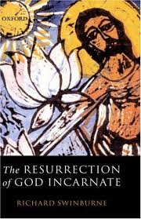

Exactly who is Jesus Christ anyway?

Slide 13
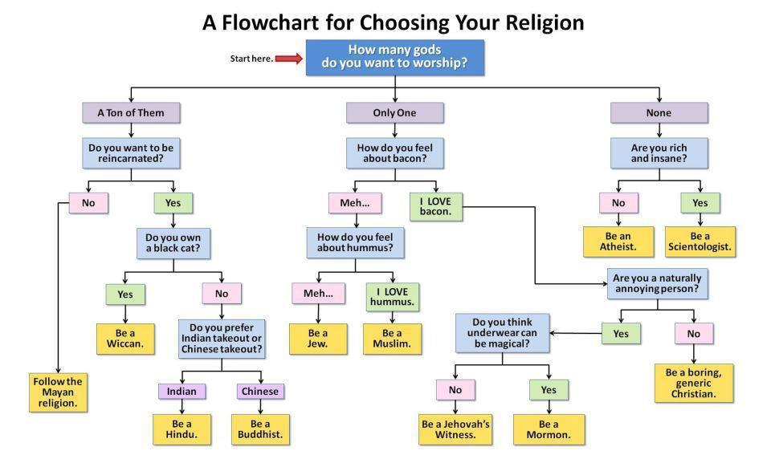
from Aaron Spiegel

Slide 14
Prologue Hebrews 1:1-4
Welcome to the most profound and doctrinally packed four verses in the Bible.
1:1 This reminds us that the Bible is divinely inspired and therefore authoritative.
You will notice as we read this letter that the author assumes his readers are well acquainted with Scripture and hold to it, as he does, with extreme reverence.

Slide 15
Prologue Hebrews 1:1-4
1:2 Jesus is the ultimate revelation of God.
He is the unique Son of God (true Deity).
As heir of all things He will one day rule in heaven and earth.
He is the instrumental cause of all things – God the Father created everything through Him.
Worlds = aiōnas = eons, ages, eternity.

Slide 16
Prologue Hebrews 1:1-4
1:3 Jesus is the brightness of God’s glory.
The author is saying that this is not a reflected brightness or glory like the light of the moon.
Instead, this is an innate brightness like a ray of light from the sun.
Christ’s glorious brightness comes, not from being like God, but being in actual fact divine.

Slide 17
Prologue Hebrews 1:1-4
1:3 He is the express image of God’s person.
The Greek word charaktēr, means “exact representation” or “perfect expression.”
In Greek literature the word was used of stamping a coin from the die.
Think also of how Chinese “characters” represent the words or things they stand for.
The Son is the perfect human expression of God’s being because He is also God Himself.

Slide 18
Prologue Hebrews 1:1-4
1:3 Jesus Himself purged our sins.
He died on the cross in order to purify us from our moral and spiritual contamination.
He then rose from the dead, ascended into heaven and is seated at the right hand of God the Father.
This is the ultimate position of authority in this or any possible universe.

Slide 19
Prologue Hebrews 1:1-4
1:4 Jesus is superior to the angels.
This means, first of all, that angels truly exist.
Secondly, it means that Christ, as God the Son, is entitled to more glory than they are.
He is appointed heir of all things.
Angels are among the “all things” Christ inherits.

Slide 20
The Biblical Case Hebrews 1:5-14
The author consistently quotes the Septuagint (LXX), the Greek translation of Hebrew Bible – so it differs slightly from our OT.
Moreover, he does so, not in a strict “copy and paste” or proof-texting way, but exercising some freedom in his interpretation and in connecting one verse to another.
Rabbis in those days would typically string Scriptures together like this in their preaching.

Slide 21
The Biblical Case Hebrews 1:5-14
1:5 See Psalm 2:7 and 2 Samuel 7:14.
1:6 See Deut. 32:43 and Psalm 97:7.
1:7 See Psalm 104:4.
1:8-9 See Psalm 45:6-7.
1:10-12 See Psalm 102:25-27.
1:13 See Psalm 110:1.
1:14 Angels are sent to serve you.

Slide 22
Christ’s Superiority to the Prophets
Ezekiel witnessed the glory of God and told us what he saw; Christ manifested that glory.
Isaiah spoke of God being holy, righteous and merciful; Jesus demonstrated those qualities.
Many prophets witnessed and described the power of God; Jesus exercised that power.
Moses was transformed by an encounter with God; Jesus transformed the lives of his closest followers – and still does today.

Slide 23
Consider this earlier question:
What would it take to keep you away from Christ or from fellowship with His followers?
  Death of someone close to you?
  Broken relationships?
  Disease?
  Social upheaval?
  Financial instability?
  Old friendships?
  Family tradition?

Slide 24
Consider this earlier question:
If the Jesus you believe in is as big as the Bible says He is, then He will be bigger to you than all of those other things.
New Testament textual scholar Daniel Wallace has said it like this:
“We need to quit turning Jesus into our buddy. He’s sovereign Lord of the universe and we need to understand that and respond accordingly.”

Slide 25
Hebrews 1: Conclusions
God Almighty has something to say to the whole human race.
That message has been communicated from God to us by men inspired by the Holy Spirit – the human authors of the Bible.
It finds its ultimate expression in the person and work of God’s glorious Son:
Our Lord Jesus Christ.

