Slide 1
CCBCi Saturday Seminar 2012
The Unpopular Doctrine of Hell
Part 4
The Traditional Doctrine and Why It Is Reasonable

Slide 2
Part 4: The Traditional Doctrine and Why It Is Reasonable
Many arguments against an eternal conscious hell come from a rational or emotional appeal.
Therefore, for the traditional doctrine to be fully acceptable, we have to get past those objections that seem to say, “This can’t possibly be true!”
It is necessary to show that our understanding of hell is not simply a wacky, crackpot, cruel or evil way to interpret the biblical texts.

Slide 3
Part 4: The Traditional Doctrine and Why It Is Reasonable
In this final section we will discuss the logic of four ideas related to the traditional doctrine of hell:
Biblical Descriptions of Fiery Torment
Eternal Punishment for Sin
The Demand to Put God First
Emphasizing a Final Choice for Christ in This Life

Slide 4
1) Biblical Descriptions of Fiery Torment
The Alleged Problem:
Images of fire and so on seem so crude or primitive that they cannot be believed by sophisticated people such as we are today.
A Better Way to See It:
Language is of this world. Language, in the Bible or out of it, is inadequate when it comes to other-worldly things.

Slide 5
1) Biblical Descriptions of Fiery Torment
When John describes the one seated on the throne in heaven he says,
“And he who sat there had the appearance of jasper and carnelian (or “sardius”), and around the throne was a rainbow that had the appearance of an emerald.” (Rev. 4:3)
Can we really understand that?
Perhaps not, but we live with the ambiguity.

Slide 6
1) Biblical Descriptions of Fiery Torment
Do Christians think of denying heaven due to the wretched inadequacy of the Bible’s descriptions of its glory?
We should apply the same logic to descriptions of hell – and live with the ambiguity.
It’s no help to say the descriptions can’t be true or can’t be literal if we only desire in the end to somehow rob them of their meaning.

Slide 7
1) Biblical Descriptions of Fiery Torment
Jesus and the other authors of Scripture had to describe hell somehow if anything even remotely like what we call hell exists.
Maybe images of a lake of fire, undying worms, weeping, gnashing of teeth and outer darkness together are the closest they could come to the reality they intended to convey.

Slide 8
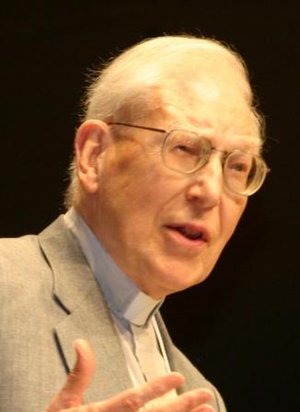
1) Biblical Descriptions of Fiery Torment
Again, let’s hear what J.I. Packer had to say.
Look at Letter A in your notes.

Slide 9
2) Eternal Punishment for Sin
The Alleged Problem:
Eternal punishment is unjust for any sin, no matter how heinous, and therefore, unbecoming a just God. Therefore, hell cannot be eternal.
One Possible Response:
It is entirely possible that we do not rightly see the wickedness of our sin, which, for all we know, may be an “infinite evil.”

Slide 10
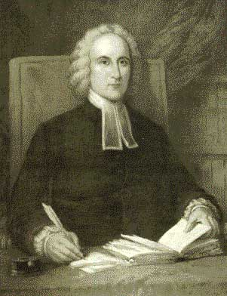
2) Eternal Punishment for Sin
See the remarks of Jonathan Edwards at B in the notes.
(According to Pinnock Edwards had cauterized his conscience to be able to say such things.)

Slide 11
2) Eternal Punishment for Sin
Maybe sin is an infinite evil, odiousness, and provocation in the eyes of God.
Maybe we have “cauterized our consciences” to the point that we no longer feel this – and instead deem God unjust for his entirely justified assessment of sin.
We have to at least admit the possibility that Edwards is right.

Slide 12
2) Eternal Punishment for Sin
A comparison may help:
In my pastoral ministry I have had the opportunity to counsel several sex offenders.
If I wanted to accurately gauge the “evil, odiousness, and provocation” involved in their crimes I would not begin by asking a random sample of sex offenders what they thought.

Slide 13
2) Eternal Punishment for Sin
The most honest and genuinely remorseful of them would have to admit they probably don’t know the full extent of the damage they’ve caused, and certainly can’t compensate for it, but it must be truly awful.
(I’ve heard such attitudes expressed.)

Slide 14
2) Eternal Punishment for Sin
The least honest, or most deluded, might try to defend themselves and/or their actions, and criticize the prosecutor, judge or jury.
Their victims, however, might have the most accurate sense of all.
A survey or series of interviews with their victims might give us a good overall picture of the damage that sex offenders cause.

Slide 15
2) Eternal Punishment for Sin
All of us have sinned against pure, majestic, infinite holiness Himself.
Do we really claim to trust our own judgment as to the evil or effect of our sin?
Would it be wise to trust the criminal’s own judgment regarding his crime?
Would it not be more sensible to ask God, the one pure and most impartial victim, against whom we have all sinned?

Slide 16
2) Eternal Punishment for Sin
And if the verdict were, as it seems to be biblically, that we are guilty and deserving of eternal or infinite retributive punishment, then it must be so and we should accept it.
Further, if our obligation toward God is actually infinite, then the punishment cannot end – unless and until an infinite price is paid.
This infinite price has been paid by the infinitely holy Christ at Calvary upon the cross.

Slide 17
2) Eternal Punishment for Sin
If it is refused, an unending sentence is the only option left.
The amount paid by suffering for any measurable amount of time, however long, will still be finite.
So the price will never be fully paid.
Not after a bazillion ages.
“How shall we escape if we neglect so great a salvation?” (Hebrews 2:3)

Slide 18
3) The Demand to Put God First
Consider again Rob Bell’s story about the two weeping women.
One of them can expect to see her loved ones again; the other cannot, even – or better, especially – if she trusts Jesus.
Her loved ones are all non-Christians and some may be in hell even as we speak.
This is dreadful news!

Slide 19
3) The Demand to Put God First
But also consider Christ’s response when asked by a lawyer what the greatest commandment was.
“And he said to him, ‘You shall love the Lord your God with all your heart and with all your soul and with all your mind. This is the great and first commandment.’”
  Matthew 22:37-38 (ESV)

Slide 20
3) The Demand to Put God First
The conflict that Woman #2 was feeling has keenly been felt by all who have put their faith in Christ though not raised in Christian homes.
Ruth left her people and her gods to go with Naomi and serve the God of Israel.

Slide 21
3) The Demand to Put God First
Paul applauds the Thessalonians saying, “…you turned to God from idols to serve the living and true God, and to wait for his Son from heaven, whom he raised from the dead, Jesus who delivers us from the wrath to come.” (1 Thessalonians 1:9-10)
Ponder the reality that God deserves nothing less than this kind of commitment from us.

Slide 22
3) The Demand to Put God First
Do we dare claim the right, let alone the need, to love anything or anyone more than him?
The internal conflict we feel when facing such a dilemma is very real and so ought never to be minimized.
It is the earthly expression of the relentless spiritual struggle that is raging over our souls.

Slide 23
4) Emphasizing a Final Choice for Christ in This Life
A common theme in authors like Rob Bell (Brian McLaren is another) is their dissatisfaction with the distinction Christians make between believers and unbelievers
They often word it as those who are “in” and those who are “out”.
To Bell and Co. this must be judgmental, so they play down the distinction altogether.

Slide 24
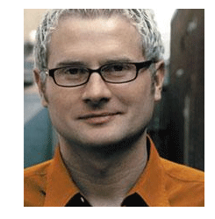
4) Emphasizing a Final Choice for Christ in This Life
The almost poetic flourish by Bell at C in your notes is typical.

Slide 25
4) Emphasizing a Final Choice for Christ in This Life
Speaking of the universe, if we all become universalists, then who needs religious distinctions?
It doesn’t matter if you are “in” or “out” because nobody ends up condemned for eternity anyway.
Everyone comes into God’s fold no matter what they have believed or what they have done. It’s all just a matter of time.

Slide 26
4) Emphasizing a Final Choice for Christ in This Life
But is this exactly like the message of Jesus?
He made some extremely sharp distinctions, which we ought to seriously consider.
For example, see John 8:23-24.
Whatever it means to “die in your sins,” Christ is clearly saying that the Pharisees ought to avoid it.
But this is also clearly dependent upon their beliefs about Him.
They must literally “believe that I am.”

Slide 27
4) Emphasizing a Final Choice for Christ in This Life
So where does this bring us as preachers or teachers, Bible believers, big-time or small-time evangelists?
It comes down to three choices:
  The traditional view of an eternal, conscious hell
  Annihilation, but perhaps after a finite time of punishment
  Universalism – all are ultimately saved

Slide 28
4) Emphasizing a Final Choice for Christ in This Life
Key Question: What if we are wrong?
If the traditionalist is wrong, he or she can only be pleasantly surprised at the mildness of hell after all.
Unless, of course, someone out there is actually eagerly looking forward to people suffering infinite retribution.

Slide 29
4) Emphasizing a Final Choice for Christ in This Life
Key Question: What if we are wrong?
If either the annihilationist or the universalist are wrong, then the consequences are dire.
It would be a tragic realization to discover that hell was unending with no possibility for repentance after believing and telling people on earth that it could not be that bad.

Slide 30
4) Emphasizing a Final Choice for Christ in This Life
Key Question: What if we are wrong?
“Horrors! The lost are not snuffed out; they are knowingly suffering! And there is no second chance!”
Making a final decision for Christ here and now was downplayed and, alas, it was the most important decision that each and every person needed to make.

Slide 31
4) Emphasizing a Final Choice for Christ in This Life
Thus, without a traditional hell, there is something to lose for evangelism.
The traditionalist ought to feel more urgency regarding the catastrophic fate of the lost.
The traditionalist possesses, hands down, the most urgent message.

Slide 32
4) Emphasizing a Final Choice for Christ in This Life
The traditionalist can have a deeper sense of the heinousness of sin and, therefore, place a greater value on Christ’s atoning sacrifice.
The traditionalist should now be motivated to love God more.
He or she, like the forgiven debtor in Luke 7, has been forgiven the greatest theological debt.

Slide 33
Part 4: The Traditional Doctrine and Why It Is Reasonable
If all three standpoints enjoyed equal biblical support (which they don’t), it would still make sense to stick to the traditional approach to hell for practical considerations alone.
If it’s true that many reject Christ because of the biblical doctrine of Hell, certainly many have also been motivated to accept Him precisely because of it.

Slide 34
Part 4: The Traditional Doctrine and Why It Is Reasonable
It is reasonable:
To believe that a hell of never-ending, conscious suffering exists.
To trust in Christ in this life in order to avoid it.
To communicate this message faithfully as part of a complete package of Christian doctrine – all of which has very down-to-earth results.

Slide 35
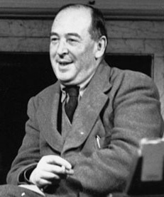
Part 4: The Traditional Doctrine and Why It Is Reasonable
We close with the words of C.S. Lewis.
You will find them at D, the final item in the notes.

