Slide 1
CCBCi Saturday Seminar 2012
The Unpopular Doctrine of Hell
January 7, 2012

Slide 2
CCBCi Saturday Seminar 2012
The Unpopular Doctrine of Hell
Part 1
The Traditional Doctrine and Why We Dislike It

Slide 3
Part 1: The Traditional Doctrine and Why We Dislike It
“All hope abandon, ye who enter in!”
These words in sombre colour I beheld
Written upon the summit of a gate;
Whence I: “Their sense is, Master, hard to me!”
– Dante’s Inferno, Canto 3

Slide 4
Part 1: The Traditional Doctrine and Why We Dislike It
Hell, in the present-day Western mindset, is perhaps the most difficult, offensive concept that Christianity has to offer the world.
Many have probably rejected Christ and the cross precisely because of this doctrine.
Popular pastor and author Rob Bell perfectly captures the emotional response that a hell-preaching Christian faith is capable of generating in the preface to his recent book, Love Wins.

Slide 5
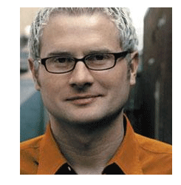
Rob Bell in the Preface to Love Wins
I’ve written this book for all those, everywhere, who have heard some version of the Jesus story that caused their pulse rate to rise, their stomach to churn, and their heart to utter those resolute words, “I would never be a part of that.”

Slide 6
Rob Bell in the Preface to Love Wins
A part of what, exactly?
What is this “version of the Jesus story” that Bell and so many others find so offensive?
It may sound somewhat familiar.
Let’s read what Bell is talking about together in your notes at B.

Slide 7
Rob Bell in the Preface to Love Wins
Some problems with what Bell says:
  Simplistic “heaven and hell” eschatology
  Choice of words, like “select few” and “the rest of humanity”
  An unfair slanting of the Christian faith
But still, this is approximately the Christian faith as we know it.
A rude caricature or parody, but not an utter falsification.

Slide 8
Rob Bell in the Preface to Love Wins
Christianity claims to be the means of saving us from sin and death and, ultimately, the fires of hell.
Most Christians believe that we humans are all lost in our sins and on our way to, yes, Hell.
The only way out of this mess is to accept Christ’s atoning death as the ransom for our salvation.
This is sounds a lot like what Bell refers to as a “stomach-churning” religion.

Slide 9
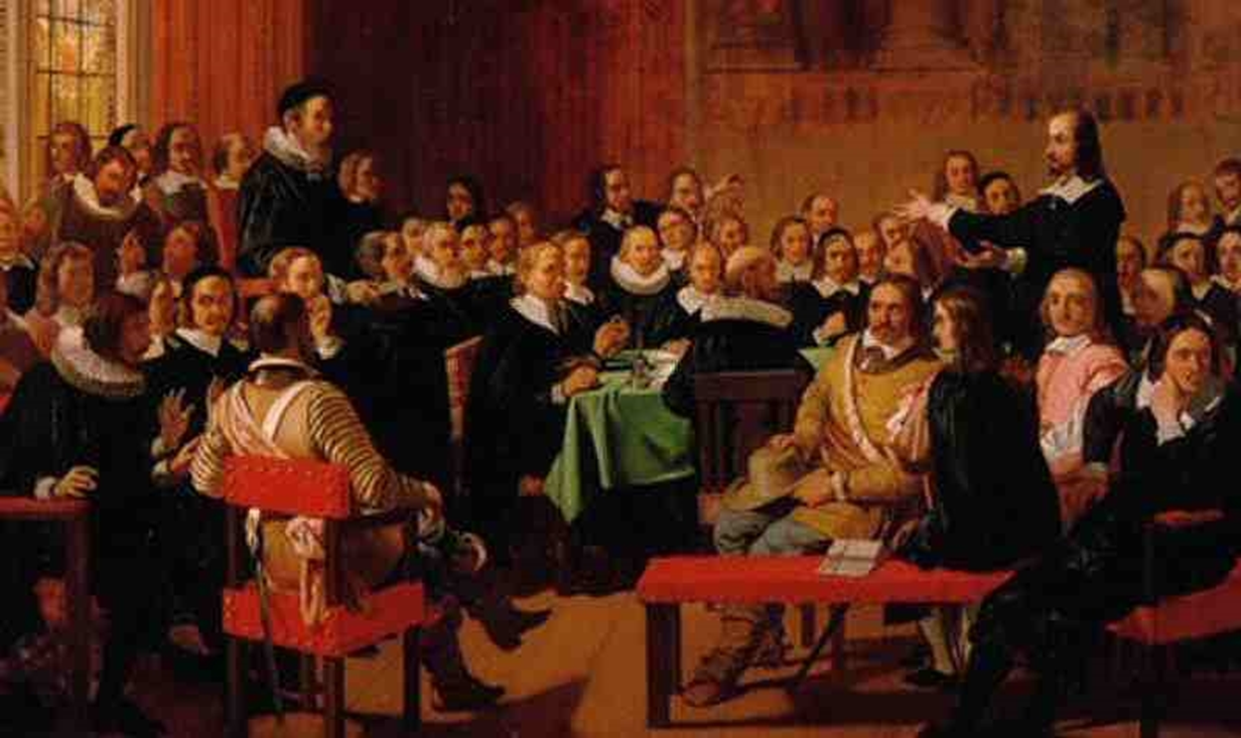
Westminster Larger Catechism
Question 29:

Slide 10
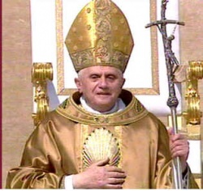
Roman Catholicism
For the Teaching of Roman Catholicism, see D in your notes. This is from the Catechism of the Catholic Church.

Slide 11
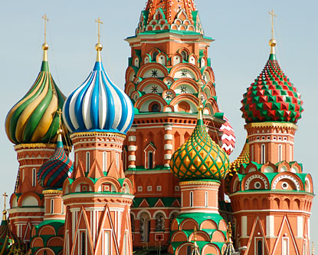
Eastern Orthodoxy
While Eastern Orthodoxy differs somewhat from the Western understanding, it agrees in the concept of “eternal conscious torment.”
For the Teaching of Eastern Orthodoxy, see E in your notes. This is from an official website of the Russian Orthodox Church.

Slide 12
Part 1: The Traditional Doctrine and Why We Dislike It
In other words Hell, as it is usually understood, has a wide official support base.
East and West, Protestant and Catholic, all see hell in a remarkably similar way.
Historically, for Christianity, it has been the stick while Heaven has been the carrot.
The carrot is still popular and socially acceptable.
The stick has gone out of style.

Slide 13

Part 1: The Traditional Doctrine and Why We Dislike It
Read what the late Clark Pinnock of McMaster Divinity College in Hamilton, Ontario said at F in the notes.

Slide 14
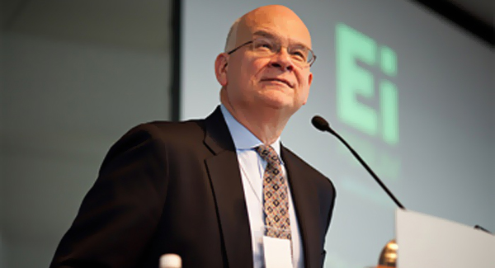
Part 1: The Traditional Doctrine and Why We Dislike It
So what, exactly, makes hell so offensive?
Tim Keller, a traditionalist with respect to hell, tries to pin it down in The Reason for God, Ch. 5.
He came up with the following explanations after numerous Q & A sessions at his midtown Manhattan church services.

Slide 15
Part 1: The Traditional Doctrine and Why We Dislike It
Sample Explanations for Why We Dislike Hell:
  A God of judgment simply can’t exist.
  A God of judgment can’t be a God of love.
  A loving God would not allow Hell.
  A belief in Hell inevitably leads to a judgmental attitude toward others.
  Belief in a loving God is at the core of all world religions.

Slide 16
Part 1: The Traditional Doctrine and Why We Dislike It
Important Considerations:
Rob Bell was, until recently, a pastor – the founding pastor of Mars Hill Bible Church outside of Grand Rapids, Michigan.
Clark Pinnock was a recognized evangelical scholar at a Baptist seminary in Canada.
These are not men outside the Christian mainstream, founders of cults, etc.
They claim to base their views on the Bible.

Slide 17
Part 1: The Traditional Doctrine and Why We Dislike It
Self-identifying Christians, in increasing numbers, are beginning to go beyond merely disliking the doctrine of hell to redefining it, calling it into question, or disbelieving it altogether.
Could they be right?
Or is the assessment of J.I. Packer more accurate?

Slide 18
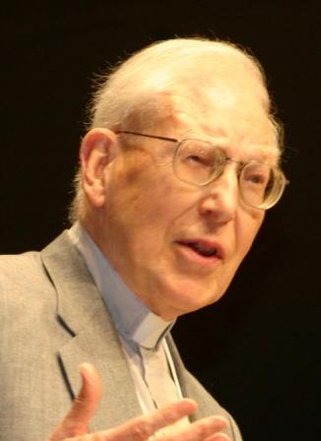
J.I. Packer in his Concise Theology
“The sentimental secularism of modern Western culture, with its exalted optimism about human nature, its shrunken idea of God, and its skepticism as to whether personal morality really matters—in other words, its decay of conscience—makes it hard for Christians to take the reality of hell seriously.”

Slide 19
If the traditional view is really somehow incorrect, what are we supposed to believe?
In our next presentation we will examine some alternatives to the traditional doctrine of Hell.

