Slide 1
Titus
Serving Christ in a Tough Environment

Slide 2
Introduction to Titus
Titus, like Timothy, was a younger disciple of Paul.
He is not mentioned in the book of Acts, but his name appears 12 times in Paul’s letters before this.
According to Galatians 2:3, Titus was a Greek – a Gentile convert.

Slide 3
Introduction to Titus
Titus is obviously someone Paul felt he could count on – someone who could handle responsibility.
Early in the letter, Paul reminds him that he left him on the island of Crete to bring more order to the churches.
Cretans were naturally uncooperative, so this would be no easy task.

Slide 4
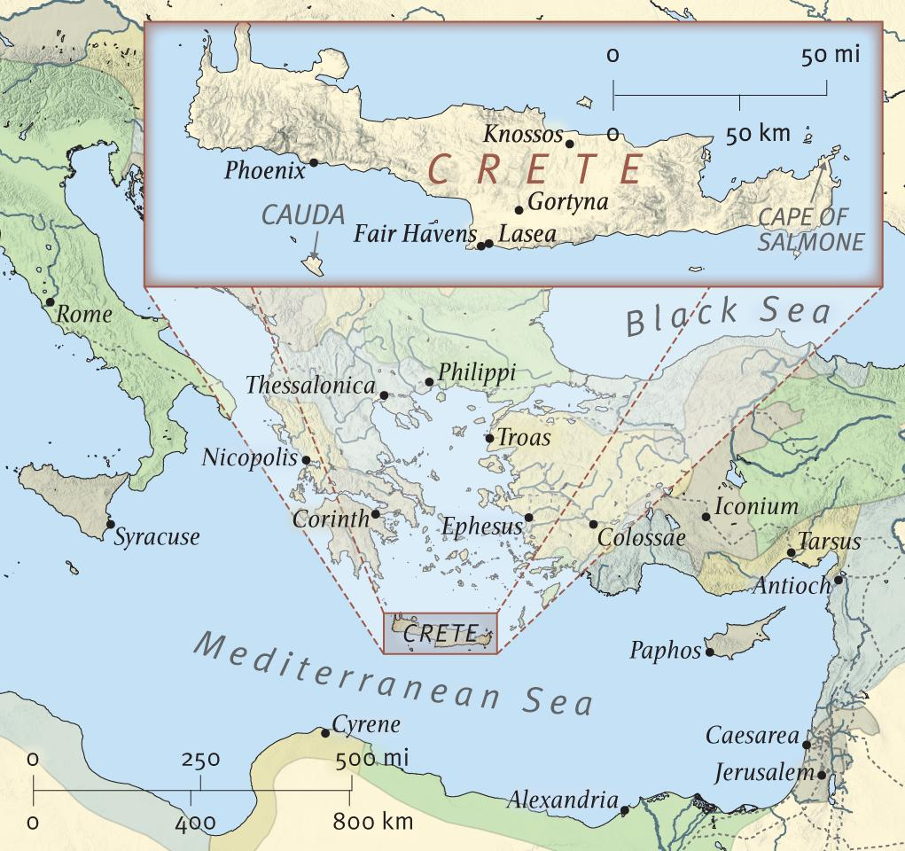

Slide 5
Introduction to Titus
Other than that, the letter contains much the same kind of information as 1 & 2 Timothy.
There is the attention to good doctrine and good works – both of which make for a healthy church.
We see a focus on leadership by example, as elsewhere in the Bible.

Slide 6
A Study of Titus
As we read through the letter, take note of the points that seem to be important. Especially notice the following:
  Right Doctrine
  Right Conduct
  Things in Common with 1 & 2 Timothy

Slide 7
A Study of Titus
Paul’s Faithful Sayings:
  1 Timothy 1:15
  1 Timothy 3:1
  1 Timothy 4:8-9
  2 Timothy 2:11-13
  Titus 3:8

Slide 8
A Study of Titus
Difficult Passages:
  Titus 1:12: Why does Paul make this pagan poet a part of inspired Scripture?
    (Epimenides of Cnossus, around 600 B.C.)
  Because he happened to say something that was true and Titus needed to be reminded of it.
  This doesn’t mean that pagan poets are inspired by God.

Slide 9
A Study of Titus
Difficult Passages:
  Titus 1:12: Isn’t Paul contradicting himself?
  Paul sensed the need to add, in v.13, that “This testimony is true.”
  In other words, “Cretans typically lie, but here’s one thing you can believe about them and a Cretan happened to say it.”

Slide 10
A Study of Titus
Difficult Passages:
  Titus 3:9-11: How does this fit in with what Paul said back in 2 Timothy 2:23-26?
  The seriousness of the response by the church leadership depends upon the attitude of the person being disciplined.
  If, after repeated warnings, the individual persists in causing trouble, only then should he be removed. Still, the goal is restoration.

Slide 11
A Study of Titus
Key Passages to Remember:
  2:11-15: God’s saving grace needs to affect our behavior. About 2:13, Pastor Chuck said:
  “Besides being one of the strongest declarations of the deity of Christ in the New Testament, this verse also reminds us to keep our eye on the sky, waiting for the Rapture of the church and living our lives knowing that Jesus could come back at any time.”

Slide 12
A Study of Titus
Key Passages to Remember:
  3:3-7: Remember where you have come from in order to appreciate what God has done in your life.

Slide 13
Life Lessons from Titus
The gospel should naturally produce godliness in the lives of believers. We must not separate belief and behavior. What we do will either prove or disprove our claim to know God.
  1:1, 16
  2:1, 11–14;
  3:4–7

Slide 14
Life Lessons from Titus
We should have godly men serving as elders/pastors. Nobody is perfect, but more than anything else, it is character that qualifies for position in the church.
  1:5–9

Slide 15
Life Lessons from Titus
A church needs to respond to doctrinal and moral error in its midst.
  (A healthy body will be able to cleanse itself from impurities.)
  1:10–16; 3:9–11

Slide 16
Life Lessons from Titus
Finally, don’t be a liar, an evil beast or a lazy glutton. It dishonors God and may explain why you have so few friends.

Slide 17
Life Lessons from Titus
Finally, don’t be a liar, an evil beast or a lazy glutton. It dishonors God and may explain why you have so few friends. Or more positively,
Authentic Christian living will make the gospel attractive to those who don’t yet believe it.
  2:5, 8, 10

