Slide 1
A Lesson on Prayer
2 Timothy 2:1-8

Slide 2
A Lesson on Prayer: Introduction
It’s interesting. Jesus never taught His disciples how to preach or teach the Bible.
Nor does it seem they ever asked Him.
But they frequently observed Him praying – the God-Man communing with His Father.
On at least one occasion they were motivated to ask Him for a lesson on the topic – so He gave them one.
Read Luke 11:1-4. We will read it in NKJV.

Slide 3
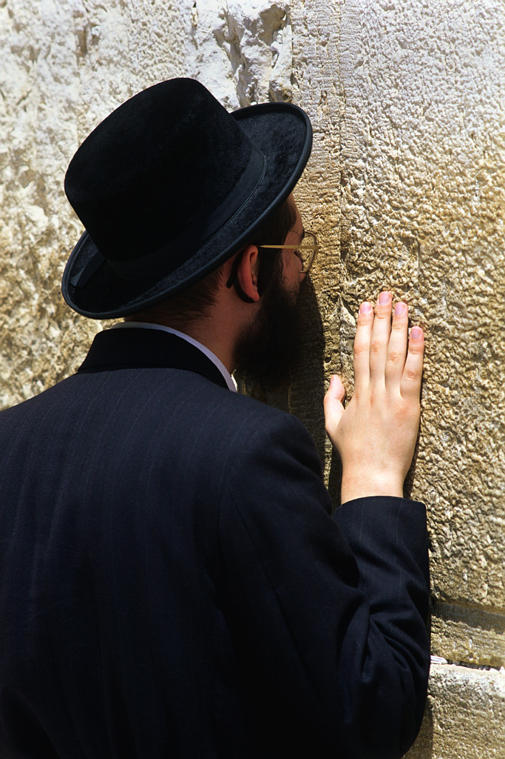
A Lesson on Prayer
Don’t think of prayer
as a last resort;
make it your
first priority.

Slide 4
A Lesson on Prayer: Outline
Our Intercession for Others 2:1-4
Christ’s Intercession for Us 2:5-7
Men Need to Pray 2:8

Slide 5
Our Intercession for Others 2:1-4
First of all here means “first in importance.”
Four different words for prayer are used in 2:1
  Supplications are prayers for definite needs.
  Prayers – the most general word for prayer.
  Intercessions suggest free access to God in order to pray for others.
  Giving of Thanks – for all that the Lord has already done and the people He has put in our lives.
Paul’s point is simply that we should pray about various things and in various ways.

Slide 6
Our Intercession for Others 2:1-4
All men (v.1) – The word here (anthropos) is very general, speaking of all “people,” not distinguishing between men and women.
The same goes for v.4 and v.5
The word in v.8 (aner) is the only one in this passage that means “men” as opposed to women.

Slide 7
Our Intercession for Others 2:1-4
Quiet and peaceable – These words both mean about the same thing: still, quiet, tranquil, composed or undisturbed.
Reverence – seriousness, honor, the characteristic of a person which entitles him/her to reverence and respect.
Verse 3 simply reminds us that God approves of all this prayer. We don’t have to ask, “Should I be praying about this?”

Slide 8
Our Intercession for Others 2:1-4
Praying for Rulers:
The Romans permitted people to worship their own gods, as long as they showed their loyalty to Rome by also worshiping the goddess Roma and the spirit of the emperor.
The Jews were exempt. Rome allowed them to pray for the emperor without praying or sacrificing to any other God but their own.
Thus, prayers for rulers were offered regularly in the synagogues. Christians adopted this practice.

Slide 9
Our Intercession for Others 2:1-4
Praying for Rulers:
Nero was emperor at this time. He became a notorious persecutor of Christians, putting many to death, including Peter and Paul.
When Paul tells us to pray for our rulers, he is not implying that we have to agree with them or their policies.
We can pray for our rulers’ salvation, ask God to use them for our good, and thank God for the freedoms that we have.

Slide 10
Our Intercession for Others 2:1-4
God’s Desire:
When God reveals His will to us clearly in the Scriptures, He gives us something to focus on, pray for and work toward.
World evangelization is one of those things and it starts with us those closest to us.
See also 2 Peter 3:9

Slide 11
Our Intercession for Others 2:1-4
Application:
We should pray for all kinds of things and all kinds of people in all kinds of ways.
We should especially pray for our rulers – and that through them we would enjoy quiet and peaceful lives.
We should also especially pray for the lost.
See the prayer card handouts.

Slide 12
A Lesson on Prayer
Don’t think of prayer
as a last resort;
make it your
first priority.

Slide 13
Christ’s Intercession for Us 2:5-7
Biblical Non-negotiables:
Monotheism – There is only one God.
  The Bible presents one God in three Persons.
  The Trinity is not a belief in three gods.
Christ is the Only Mediator
  He alone is fully God and fully human
  He is therefore the only perfect Mediator or Arbitrator between God and all of us.

Slide 14
Christ’s Intercession for Us 2:5-7
Biblical Non-negotiables:
Substitutionary Atonement – Christ gave Himself as a ransom.
  The word ransom (antilutron) emphasizes that something is given in place of something else.
  Jesus took our place on the cross.
  In so doing He paid the just penalty for our sin and freed us from slavery to sin and death.
  See also Matthew 20:28 and Mark 10:45.

Slide 15
Christ’s Intercession for Us 2:5-7
Consequences of Christ’s Atonement:
Through faith in Christ we have free access to God the Father.
The moment Christ died, the veil or curtain that set apart the Holiest Place in the Temple was torn in two from top to bottom.
This means we now have both the privilege and responsibility to go into God’s presence in prayer and worship. See Hebrews 10:19-22

Slide 16
A Lesson on Prayer
Don’t think of prayer
as a last resort;
make it your
first priority.

Slide 17
Men Need to Pray 2:8
This is the one place in this passage where the word for men literally means “adult males”.
Paul is not speaking here to women or children, not even to boys – but men.
Men normally respond best to simple, clearly defined goals. Paul limits his instructions to one verse so Timothy doesn’t have to beat around the bush. Men need to pray.

Slide 18
Men Need to Pray 2:8
Hindrances to Effective Prayer:
Lack of holiness – Holy hands imply that the men’s lives need to be pure to make their prayer more effective.
Anger and disputing – Doubt can indeed hinder prayer, but the word here means something more like “quarreling”.
A bad relationship with your wife – Not listed here, but see 1 Peter 3:7.

Slide 19
A Lesson on Prayer
Don’t think of prayer
as a last resort;
make it your
first priority.

Slide 20
A Lesson on Prayer: Conclusions
We should pray for all kinds of things and all kinds of people in all kinds of ways.
We should especially pray for our rulers – and that through them we would enjoy quiet and peaceful lives.
We should also especially pray for the lost.

Slide 21
A Lesson on Prayer: Conclusions
Our access to God is not based on any merit of our own, but on the fact that Christ took the penalty for our sin, giving us free access to God the Father through faith in Him.
Men especially need to pray. Perhaps they specifically need to learn to be less self-reliant and more God-reliant.

Slide 22
A Lesson on Prayer: Conclusions
The purpose of prayer is not to get our will done in heaven but to get God’s will done on earth.
We have no record of Jesus ever teaching His disciples how to preach. He did, however, teach them how to pray.
Let’s pray Matthew 6:9-13 (NKJV) i.e., with “debts” rather than “trespasses,” and the “kingdom, power and glory” tag on the end.

Slide 23
Next Week:
Godly Womanhood
2 Timothy 2:9-15

