Slide 1
Characteristics of a
Model Church
2 Thessalonians 1

Slide 2
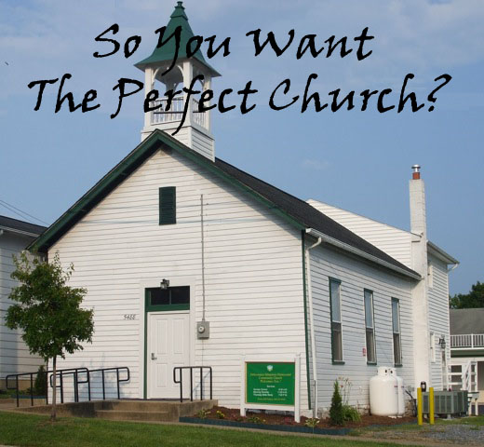

Slide 3
2 Thessalonians 1
A Model Church:

Slide 4
1. Is in Christ (v.1)
We live in a diverse nation in an even more diverse world.
Pluralism at many levels is simply a fact of life.
As Christians, we need to treat all people with love and respect.
This does not mean, however, that we think all beliefs, even religious ones, are equally true.
Unwavering belief in the unique and exclusive claims of Jesus Christ is what makes a church a truly Christian church. Accept no substitutes.

Slide 5
2. Experiences God’s Grace (v.2)
Grace is “God’s Riches At Christ’s Expense”.
It is God’s unmerited favor which He freely grants to all who receive by faith Jesus Christ’s substitutionary work for them on the cross.
God gives to us humans the opposite of what we deserve: blessing instead of judgment.
This is the grace of God.

Slide 6
3. Enjoys God’s Peace (v.2)
Wishing someone God’s peace, or shalom was and is the traditional Jewish form of greeting.
Shalom implies more than the cessation of hostilities or peace as opposed to war.
The Complete Word Study Dictionary explains it as:
  harmony, peace of mind, tranquility, wholeness, soundness, hence health, well-being, prosperity and every kind of good.

Slide 7
4. Is Thankful to God (v.3)
In this case it is Paul, not the church, who is giving thanks.
Still, just as Paul expresses an obligation to give thanks for the Thessalonians, the Bible is clear as to the essential role of thanksgiving in our lives – and in a model church.
  See 1 Thess. 5:18
  See also Ephesians 5:3-4, 20

Slide 8
5. Is Growing in Faith (v.3)
A growing faith is associated with difficulties.
  See James 1:2-4
George Müller was a pastor used by God to provide for thousands of orphans and numerous missionaries. He said:
“To learn strong faith is to endure great trials. I have learned my faith by standing firm amid severe testings.”

Slide 9
5. Is Growing in Faith (v.3)
One of the men George Muller supported was another great man of faith, James Hudson Taylor, founder of the China Inland Mission.
He said:
“I have found that there are three stages in every great work of God: first, it is impossible, then it is difficult, then it is done.”

Slide 10
6. Is Abounding in Love (v.3)
In 1 Thessalonians 3:12 Paul prayed for this abounding love.
He now perceives the answer to his prayer.
Notice that every one of the Thessalonian Christians was expressing this abounding love toward others.
See also 1 John 4:12

Slide 11
7. Is Patient in Troubles (v.4)
We’ve touched on this already regarding faith.
  See also 2 Corinthians 4:16-18
Warren Wiersbe puts it like this:
“If we rebel and fight our circumstances, then we will remain immature and impatient. God permits trials that He might build character into our lives. He can grow a mushroom overnight, but it takes many years—and many storms—to build a mighty oak.”

Slide 12
8. Is Willing to Suffer Unjustly for Christ (vv. 4-5)
Perhaps the least popular of the beatitudes is found in Matthew 5:11-12.
The early church father Tertullian said:
“The blood of the martyrs is the seed of the church.”
Finally, listen to Peter in 1 Peter 4:14-16.

Slide 13
9. Understands the Reality of
God’s Judgment (vv. 5-8)
We frequently associate “judgment” or “vengeance” with something automatically unfair or excessively cruel.
To “judge someone” then seems just wrong.
Perhaps this is because we do so often judge people or their actions unfairly.
We may also confuse God with people who are genuinely hateful.

Slide 14
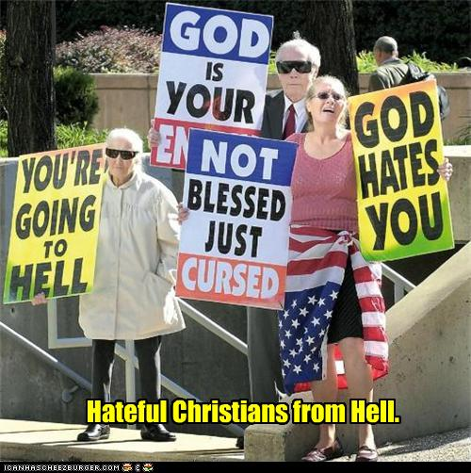

Slide 15
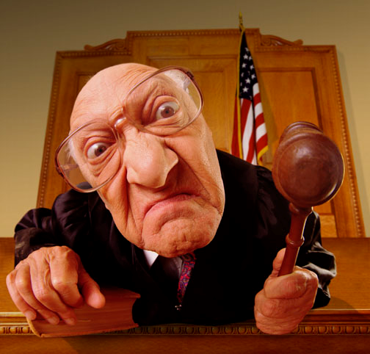
But this can never be true of God.

Slide 16
9. Understands the Reality of
God’s Judgment (vv. 5-8)
The word translated “judgment” in v.5 pertains to an opinion or a decision concerning anything, but especially having to do with justice or injustice, right or wrong.
The word “vengeance” in v.8 is directly related to the words righteous and just.
Divine vengeance is always completely without subjective bias or personal spite. It is neither more nor less than absolute justice.

Slide 17
9. Understands the Reality of
God’s Judgment (vv. 5-8)
One of the best perspectives regarding God’s judgment or vengeance was illustrated by C. S. Lewis in The Lion, the Witch and the Wardrobe, before the children first meet Aslan.
Lewis rightly observed that a just and holy God is really a rather frightening idea.

Slide 18
10. Understands the Reality of Hell (v.9)
The concept of hell has taken a severe beating in recent years.
Many “new evangelicals” now see it as an outdated or unnecessary doctrine.
Admittedly, no one especially likes the idea of hell, but the only proper question to ask is, “What does the Bible teach?”

Slide 19
10. Understands the Reality of Hell (v.9)
Some explain away hell by saying it refers to the annihilation of the lost – that they cease to exist.
But annihilation would only take an instant and their punishment or destruction is said to be “everlasting” – just like “everlasting” life.

Slide 20
10. Understands the Reality of Hell (v.9)
Jesus repeatedly referred to hell as involving “weeping and gnashing of teeth” (Matt. 8:12, 22:13, 24:51, 25:30). This indicates people are conscious.
Revelation 22:10 speaks of the devil, the beast and the false prophet being “tormented day and night forever and ever.” All the lost eventually join them in the lake of fire.

Slide 21
10. Understands the Reality of Hell (v.9)
The fire is not the worst part of hell. Daniel’s friends were in the fiery furnace (Daniel 3) and were completely at peace and unharmed for God was with them.
The thing that makes hell intolerable is that its occupants are separated from God’s presence.
This comes out more clearly in some other translations: See 1 Thess 1:9 in ESV or NLT.

Slide 22
10. Understands the Reality of Hell (v.9)
Finally, let’s hear a bit more of what Jesus has to say on the matter in Matthew 25:41 & 46.

Slide 23
11. Looks Forward to Christ’s
Return (v.10)
The return of Jesus Christ comes up in almost every book of the New Testament.
It comes up multiple times here in 1 & 2 Thessalonians.
The second to last verse in the Bible, the one before “Grace … be with you all. Amen,” reads as follows:
  See Revelation 22:20

Slide 24
12. Is Always in Prayer (v.11)
Again, Paul offers himself as an example of constant prayer in v.11.
But he earlier expressed that constant prayer is what he desired for the church.
  See 1 Thessalonians 5:17

Slide 25
13. Is Alive with God’s Power (v.11)
The Christian life simply cannot be successfully lived without that unmistakable supernatural component that is the power of the Holy Spirit.
Jesus said that His Father would give the Holy Spirit to anyone who would simply ask.
  See Luke 11:11-13.
This power is what takes us from simple head knowledge of God to a living, victorious faith.

Slide 26
14. Brings Glory to the Name of Jesus Christ (v.12)
Paul also prayed for this in Ephesians 3:20-21.
Peter states it well along with a warning at the end of his second letter.
  See 2 Peter 3:17-18

Slide 27

Review: A Model Church

Slide 28
Review: A Model Church
1. Is in Christ
2. Experiences God’s Grace
3. Enjoys God’s Peace
4. Is Thankful to God
5. Is Growing in Faith
6. Is Abounding in Love
7. Is Patient in Troubles

Slide 29
Review: A Model Church
8. Is Willing to Suffer Unjustly for Christ
9. Understands the Reality of God’s Judgment
10. Understands the Reality of Hell
11. Looks Forward to Christ’s Return
12. Is Always in Prayer
13. Is Alive with God’s Power
14. Brings Glory to the Name of Jesus Christ

Slide 30
Next Week:
More on the Day of the Lord
2 Thessalonians 2

